Slide 1
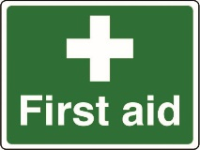
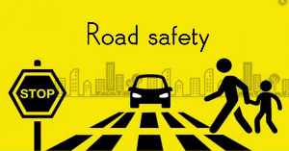
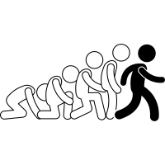
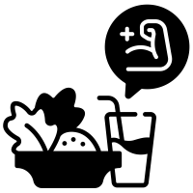
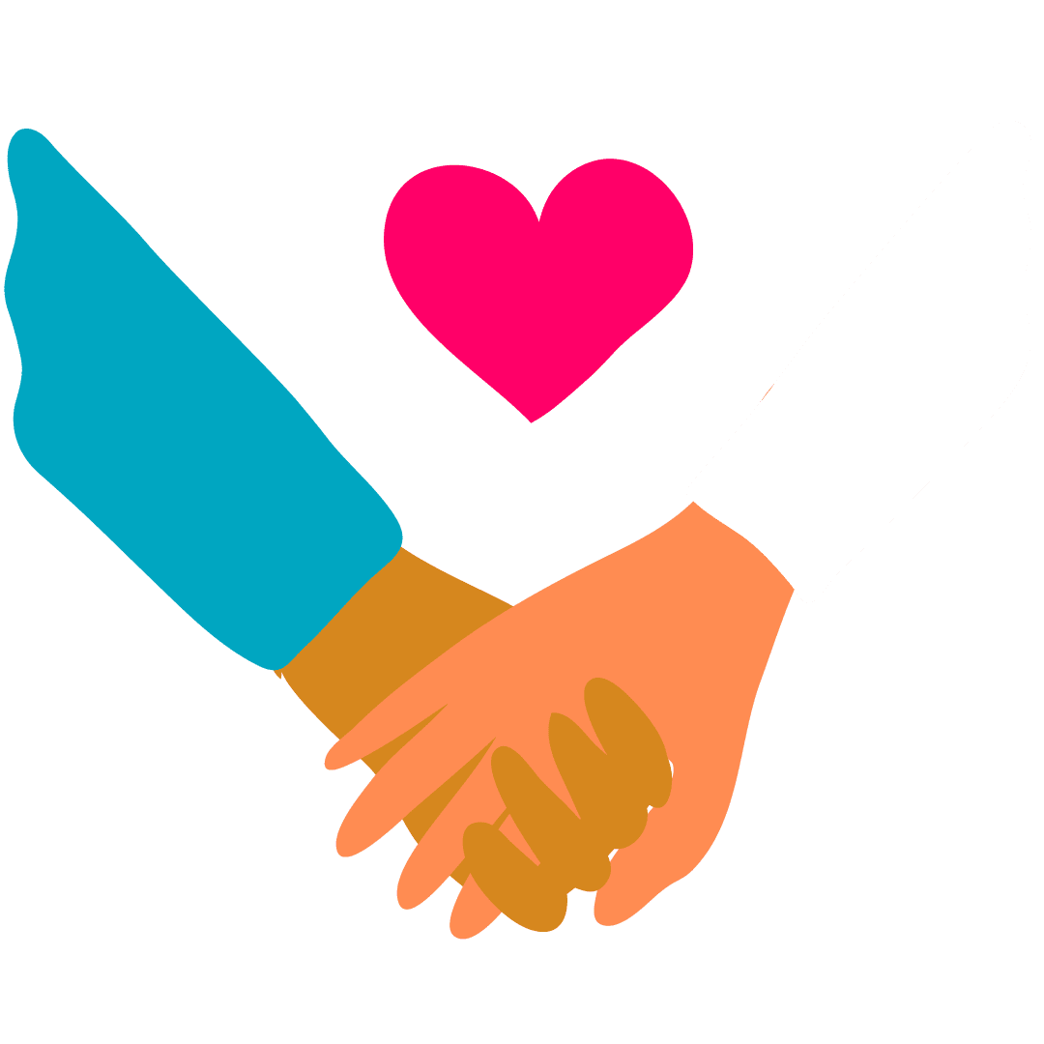
Subject learning journey – PSHE
The world I live in
Community action 1 2
Preparation for work 1 2
Managing own money 1 2
Your money in the future 1 2
Environmental awareness 1 2
Managing feelings
Managing social relationships 1 2
Self-care
Making the most of leisure time 1 2
YEAR
ASDAN- LEVEL
13
Changing and growing
Parenting Awareness 1 2
Self-Awareness
Identity and cultural diversity 1 2
Individual rights and responsibilities 1 2
Healthy lifestyles
Healthy living 1 2
Healthy eating 1 2
Food safety in the home and community 1 2
Self-care
Making the most of leisure time 1 2 3
Personal safety in the home and community 1 3
Using technology in the home and community 1 3
The world I live in
Community action 1 2 3
Environmental awareness 1 2 3
Making own money 1 2
Managing own money 1 3
Preparation for work 1 3
Managing feelings
Dealing with problems in everyday life 2 3
Managing social relationships 2 3
Working as part of a group 3
YEAR
12
ASDAN- ENTRY LEVEL 1,2 and 3
Healthy lifestyles
Healthy living 1 2 3
Self-Awareness
Developing self 2 3
Individual rights and responsibilities 2 3
Working towards goals 3
Changing and growing
Parenting needs 1
Parenting awareness 2 3
Managing Feelings
Communication in relationships
What do I do if someone is harming me?
The world I live in
Living in the Wider World
Self Care
Independence
How am I independent?
YEAR
11
Changing and Growing
Families - What are my choices around pregnancy?
Self-Awareness
Next steps
What careers am I interested in? How do I get there? What are my options?
Healthy Lifestyles
Building for the future
What is being self-sufficient? What do I need to practise? What do I do if I am stressed?
Self Care
Exploring influence
What is a role model? How can the people around me affect my life?
The world I live in
Work experience
What skills do I have for working life?
Managing Feelings
Addressing extremism and radicalisation
How do I challenge stereotypes?
YEAR
10
Healthy Lifestyles
Mental health
What is substance abuse?
Self-Awareness
Financial decision making
What is the impact of advertising?
What is good advertising?
Changing and Growing
Healthy relationships
What do different relationships look like?
Managing Feelings
Respectful relationships
What kinds of different families are there?
The world I live in
Employability skills
What can I share online?
Self Care
Healthy lifestyle
What to do in an emergency?
YEAR
9
Changing and Growing
Intimate relationships
What happens if a relationship fails?
Self-Awareness
Setting goals
What are my short term goals?
What are my long term goals?
What are my career goals?
Healthy Lifestyles
Peer influence, substance use and gangs What are the risks of taking drugs, alcohol and tobacco? What is harassment?
Self Care
Emotional wellbeing
How does the media effect my body image?
The world I live in
Digital literacy
What are risky online behaviours?
Managing Feelings
Discrimination
What are human rights?
What is discrimination?
YEAR
8
Healthy Lifestyles
Drugs and alcohol
What is the difference between medicine and illegal drugs?
Self-Awareness
Community and careers
How can I stay safe in the community?
Changing and Growing
Identity and relationships
How do I make sense of my gender and sexuality?
What is consent?
Managing Feelings
Diversity
How do I deal with unkind behaviour?
The world I live in
Financial decision making
How do I run a desert Island?
Self Care
Health and puberty
How can I keep my mind and body healthy? What is puberty?
YEAR
7
Changing and Growing
Building relationships
What is a good friend?
What is a girlfriend and boyfriend?
Self-Awareness
Developing skills and aspirations
What are my dreams and aspirations?
Healthy Lifestyles
Transition and safety
What is the same? What is different? (primary)
What should I do if I feel unwell?

Slide 2
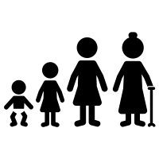
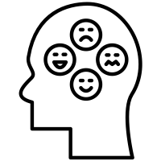
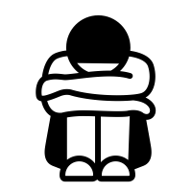
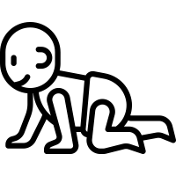
Why is it important to
include everyone?
What are the protected
characteristics?
Subject learning journey – PSHE
Changing and Growing
What will happen to my body in puberty?
The world I live in
Why are jobs important? What can we do with wages?
Self Care
What does online safety mean?
Who can I tell if I see something inappropriate?
YEAR
6
Managing Feelings
What are my triggers? How can I tell people why I am angry?
Self-Awareness
Why is it important to include everyone? What are the protected
characteristics?
Healthy Lifestyles
Which medicines are
good? Which are bad?
Self Care
What is public and what is private?
How do I keep my body and thoughts private?
Changing and Growing
What are loving
relationships? How can I show that I love
someone?
The world I live in
How do children live around the world?
YEAR
5
Healthy Lifestyles
What is the link between exercise and hygiene?
Self-Awareness
How can we recognise
bullying? How can we report it?
Managing Feelings
What are my rights and responsibilities?
Changing and Growing
What are the different
ways I grow? How am I changing?
The world I live in
Who is in our community? What can we do in our local community?
Self Care
What does trust mean?
Who can I trust?
YEAR
4
Managing Feelings
What should I do when I feel overwhelmed? Why do I have big
feelings?
Self-Awareness
How can we work as a
team?
Healthy Lifestyles
What should I eat?
How can I be physically
and mentally healthy?
Self Care
What is the difference between a secret and a surprise?
The world I live in
How can I look after living things?
Changing and Growing
What does consent mean?
How can I give or ask for
consent?
YEAR
3
Healthy Lifestyles
What happens at the hospital?
Who works there?
Self-Awareness
What is teasing? What should we do if we get teased?
Managing Feelings
What can I do if I feel lonely?
Changing and Growing
What are the different parts of my body called? How can I keep my body safe and private?
The world I live in
What can we buy at the shops?
How can we pay at the shops?
Self Care
How can I keep my personal belongings safe?
YEAR
2
Managing Feelings
How does healthy eating and exercise affect our mood?
Self-Awareness
How do we take turns and
share?
Healthy Lifestyles
How can I keep my body clean?
Self Care
Who helps me?
Who can I ask for help?
The world I live in
Are our families the same
or different?
Who is in my family?
Changing and Growing
What do babies need?
How do babies change?
YEAR
1
Changing and Growing
Work in pairs to succeed in a challenge.
Building strategies to make new friends.
Healthy Lifestyles
What are healthy and
unhealthy foods?
Self-Awareness
What is kindness?
Managing Feelings
What are my emotions?
How can I stay calm?
The world I live in
Engage in games with different roles.
Challenge undesirable behaviour.
Follow classroom expectations.
Self Care
Articulate how to solve simple problems.
Teeth cleaning. Handwashing and food preparation.
Follow classroom routines Self-help with clothing.
EYFS
Managing Feelings
Engage in more complex and extended turn taking games
Read facial expressions and body language. and extending the vocabulary of emotions.
Articulating reasons for success or failure in a challenge.
Build a vocabulary around feelings.
Self-Awareness
Perform confidently to an audience in s simple adult structured presentation..
Define what makes me special
Healthy Lifestyles
Healthy snacks
Identify healthy ingredients in healthy snacks.
Distinguish between healthy food choices and special treats.

