Slide 1
Subject learning journey – (Computing)
GCSE Computer Science
Fundamentals of algorithms, data representation and computer networks, Computer systems
Programming
Cyber security
Ethical, legal and environmental impacts of digital technology on wider society, including issues of privacy
13
Unit award ICT - AQA
Individual units selected for each class covering Computer science, Information communication technology, and Online safety and using the internet.
Raspberry Pi
G.I.M.P
Digital editing - Photoshop
Scanography
Functional skills
The internet, Email, Word processing, Spreadsheets, Charts and Graphs, Presentations, Databases.
12
Functional ICT – Entry Level 3, Level 1 and Level 2
Podcasting
Media skills – journalism, audio production.
Employability and CV skills.
Online safety
Freedom of expression and legal accountabilities, Social media, artificial intelligence.
Communication
Understand search engine rankings.
How searches are influenced.
Responsible communication.
Programming
Variables in Games to create a scoreboard in a game.
Introduction to Micro:bits
11
Creating media
Web page creation.
3-D modelling
Data and information
Spreadsheets and using formulas to produce calculated data.
Programming
Programming languages, data types.
Selection and iteration.
Modular programming, testing and validation
Online safety
Harmful or coercive online communication.
Understand how the security of devices connected to the internet may be compromised.
10
Networking
Networks, internet security, Creating web pages using HTML and CSS, ethics.
Theory
Computational thinking concepts.
Operating systems and user interface.
Computer architecture and logic gates.
Creating media
Stop-frame animation and story-based animation which includes music and text.
Photo editing – explore how images can be changed and edited, and how they can then be resaved and reused. Consider the impact of photo editing.
Programming
Create a piano using sound, motion and event blocks.
9
Impact of technology
Create a poster and slides about rebranding a charity.
Online safety
Stereotyping and the media.
Fact or fiction on the internet
Copyright and respecting ownership
Using search engines effectively.
Algorithms
Represent algorithms as flow charts.
Explore binary code. Introduce conditions such as ‘if-when-else’ in code.
Scratch
Design, write and develop a variety of games using scratch.
8
Online safety
Digital personality and what you put online.
Respectful online communication.
Cyberbullying.
Multimedia text and images
Use of Word, PowerPoint and Publisher to present work on areas of interest.
7
Multimedia sound and motion
Continue developing skills in writing algorithms as well as editing and debugging existing codes.
Radio station.
Turtle Logo programming.
Online safety
The internet and personal information.
Secure and memorable passwords.
How and where to seek help.

Slide 2
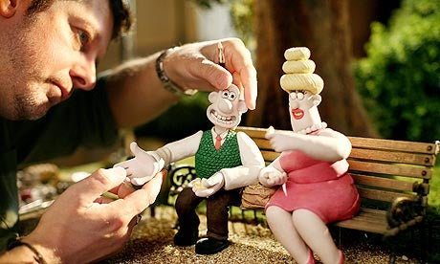
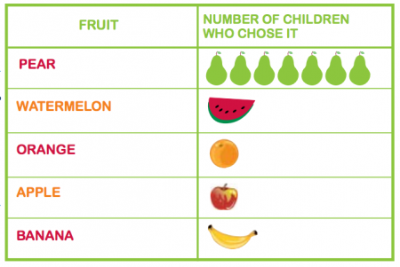
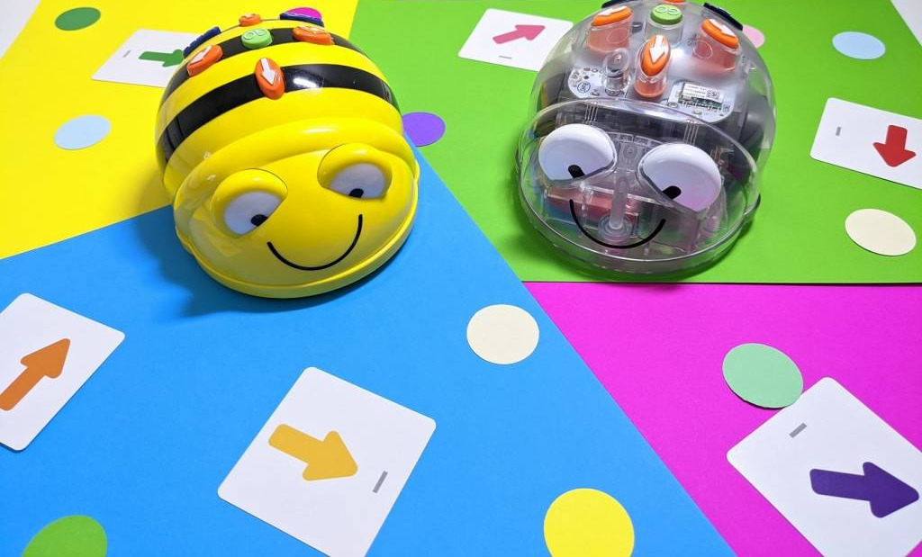
Subject learning journey – (Computing)
Data and information
Explore spreadsheets and inputting data.
Creating media
Explore various aspects of film-making.
Write and record a documentary.
Explore digital 3D modelling.
Computational thinking
Learn what variables are, and relate them to real-world examples of values that can be set and changed.
Plan and program a game.
6
Computing systems and networks
Investigate and evaluate which methods of internet communication to use for particular purposes
Online safety
Understand ‘digital reputation’ is and what it can consist of.
How to capture evidence of online bullying.
Computational thinking
Begin to explore a text based programming language.
Create a quiz using selection.
Creating media
Capture, edit, manipulate and evaluate videos.
Learn how to use different drawing tools to create vector drawings.
Data and information
Order, sort and group data. Use search tools to answer questions about data.
5
Online safety
Consider ways technology can affect healthy sleep.
Online and real world bullying.
Computing systems and networks
Explore how the Internet enables us to collaborate.
Understand email.
Data and information
Describe and group objects to collect data.
Present data in a variety of ways e.g. bar chart.
Creating media
Plan, record and edit an audio recording.
Explore photo editing and its impact.
Computational thinking
Sequence music and create a simple game. Explore sound, action and repetition blocks in Scratch.
4
Computing systems and networks
The internet – explore and learn who owns online content.
Understand the consequences of false information.
Online safety
Consider when to limit the amount of time using technology.
Be aware of methods used to persuade people to buy online.
Computational thinking
Plan and create an algorithm to program a robot to achieve a goal.
Debug simple code.
Creating media
Stop frame animation. Storyboard, sequence pictures, evaluate success.
Data and information
Branching databases - Sort groups of objects by using yes/no questions.
3
Online safety
Consider the negative impact of technology.
Understand age restrictions.
Computing systems and networks
Develop understanding of digital devices, with an initial focus on inputs, processes, and outputs.
Data and information
Match, group and label objects.
Record data in tally charts and pictograms.
Creating media
Record and sequence sounds.
Take digital photos.
Improve compositions.
Computational thinking
Create algorithms by sequencing programming blocks.
Predict an outcome using clues.
Create an animation and quiz.
2
Technology around us
Identify and describe some uses of computers.
Recognise common uses of information technology beyond school.
Online safety
Explain simple guidance for using technology in different settings.
Online identities vs. Real life.
Computational thinking
Understand algorithms as instructions.
Give commands, directions and instructions.
Use floor robots
purposefully.
Creating media
Draw and write on digital devices.
Explore editing tools.
Data and information
Group and label objects. Describe properties of objects. Compare groups of objects.
1
Online safety
Use technology safely and respectfully and know how to get help.
Keep personal information safe.
Technology around us
Explore components of digital devices e.g. mouse.
Identify technology used in the world around us.
Data and information
Identify, sort and sequence physical objects.
Spot patterns.
Creating media
Tinker with and mark make on digital devices.
Record sounds, images and videos using digital devices.
EYFS
Computational thinking
Follow instructions.
Problem solving and perseverance.
Listen and collaborate with others.
Thoughtful questioning.
Tinker with floor robots.
Technology around us
Recognise technology at home, school and in the community.
Explore cause and effect using digital devices.
Online safety
Rules to keep us safe and healthy when using technology.
Identify likes and dislikes.
Learn ‘no’ and ‘stop’.

Slide 3
To help keep a consistent format - please use font: Calibri (Body)
Please use this web link to add any images:
Noun Project: Free Icons & Stock Photos for Everything (thenounproject.com)
Please copy and paste the timeline markers

