Slide 1
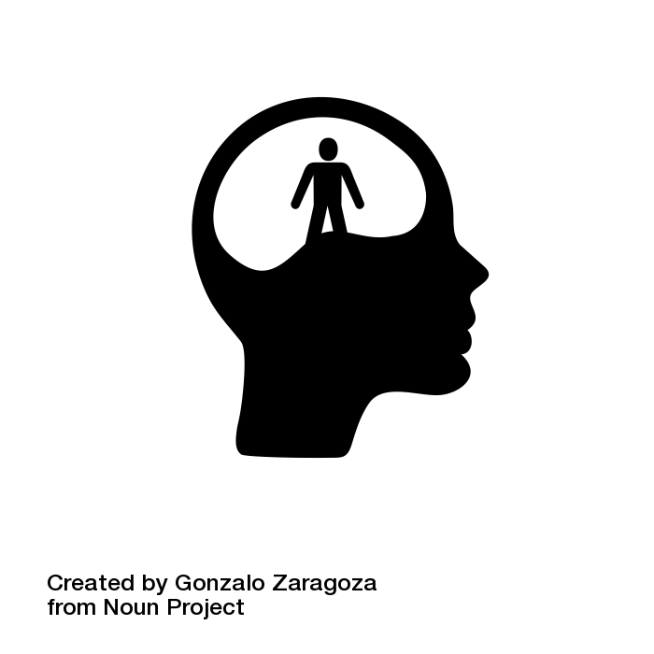
Subject learning journey – (RE)
Pupils learn about various religious and philosophical viewpoints regarding the inherent ethical nature of human beings.
Understand what lies behind the commitment to create religious art and music in the various religions
Understand that each pathway to God is not more important than the other but that individuals can respond to the idea of God in different ways.
ASDAN
Establish the facts and consider the evidence.
Talk about and consider all the possibilities.
Pupils think about the sounds that are meaningful to them.
Reflect on their own beliefs and gain knowledge and respect for the beliefs of others.
Animal Right act
RSPCA Visit/Visitor
St Gabriel’s Church Heaton
Moral Dilemmas
Pupils learn that sound is capable of provoking a variety of associations, feelings and sensations, including awe.
Spirituality through music.
Evolution or creation?
To understand the rule of law regarding animal rights and conservation.
Establish the facts and consider the evidence.
Begin to understand what a moral issue is and the meaning of the words “moral choices”.
Human beings have used sound and music since prehistoric times to create special.
What do religions and non-religious literature and texts teach about our treatment of animals?
Harm no living thing?
STEP
Investigating Religion in Modern Society
11
North east humanists- Visit/visitors
INFLUENCES AND EXPERIENCE that affect the kind of people we are and the decisions we makes.
Pupils begin to consider whether it is useful or dangerous to view the media as a source of moral authority.
Investigating the Jewish practise
To consider the role of individual conscience when making decisions.
LANGUAGE - the ability to read/write languages.
Christianity and modern miracle
Why does Jerusalem matter?
How do humanists work out what is right or wrong?
What makes us human?
Arguments for and against.
Investigate the differences between a miracle, a mystery and magic
Investigating the Islamic believes and teaching
Comparing Islam. Christianity and Judaism.
MIND - to helps us think and decide
INTELLIGENCE- the ability to think and reflect, to apply knowledge to learning
Can miracles happen?
STEP
What would you do and why?
10
Investigating Religion
Expressing (religious and spiritual forms of expression; questions of identity and diversity)
Develop their application of knowledge and critical evaluation skills
What is a human?
Describe what some believers say and do when they pray .
Argument for and against.
Pupils begin to see that their own ability to reason and a sense of conscience can be sources of moral authority.
Humanism
Where do humanists find the truth?
MORALITY- a sense of right and wrong value
Describe ways in which prayer can comfort and challenge believers.
To understand how poverty can effect adults and young people in the world.
Human right act.
What is poverty?
What is wealth?
What famous Humanist can we learn about?
Why do people pray?
Global issues
What do humanists believe about life and death?
Explain similarities and differences between how people pray .
What do differing worldviews say about wealth and poverty in our world today?
Exploring different religion and their attitude to wealth and poverty.
Poverty and Wealth, Expression of religion and Humanism
STEP
9
Continue to build upon application of knowledge and critical evaluation skills.
Discuss how the world began according to different religions.
Discuss own personal views .
Builds on the Y7 Autumn term topic introduction to Ethics.
What can we find out about differing religious and non-religious worldviews (e.g. humanism, Bahá’í)?
What is humanism ?
Critical evaluation skills
What is Bahai?
Can we define religion?
Arguments for and against the existence of God
Identifying similarities and differences .
Origins of philosophy
STAGE
Ethics, Worldviews upon religion and Media
8
Exploring political view points in relation to religion
How does the media portray religion?
What role does media play in religion?
Exploring different types of media
To discuss if ,media is a positive or negative addition to society ?
Continue to develop their application of knowledge and critical evaluation skills
Exploration of philosophical and ethical questions
Westgate Baptist Church
STAGE
Christianity, Sikism and Islam
7
The Christmas story
Recap on Christianity
Recap - Introduction to Islam
How do the beliefs of Sikhs impact on their daily lives and actions.
impact of these on the lives of Sikhs in today’s society.
The creation story
How do the beliefs of Christians impact on their daily lives and communities?
Christian beliefs and teachings.
What do Muslims believe?
Bahai Local Spiritual Assembly
What does it mean to belong or to not belong to a community
The Easter story
The Georgian calendars and the Islamic calendar
Ramadan
The 10 commands of the bible
Celebration of Guru Nanak's birthday.
Explore the beliefs, teachings & practices of Sikhism
The Five Pillars of Islam
Explore places of worship

Slide 2
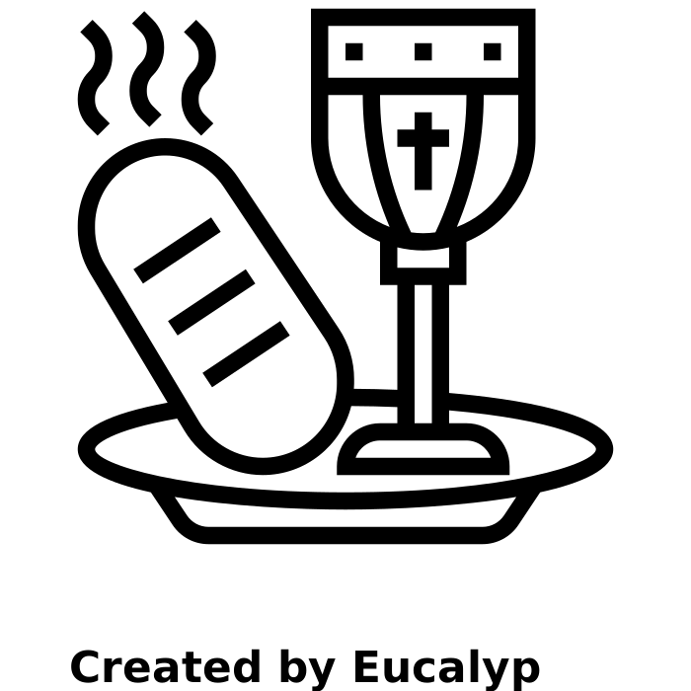
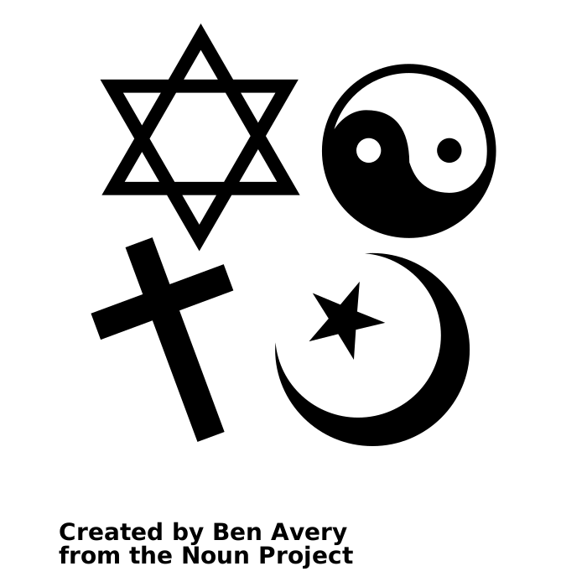
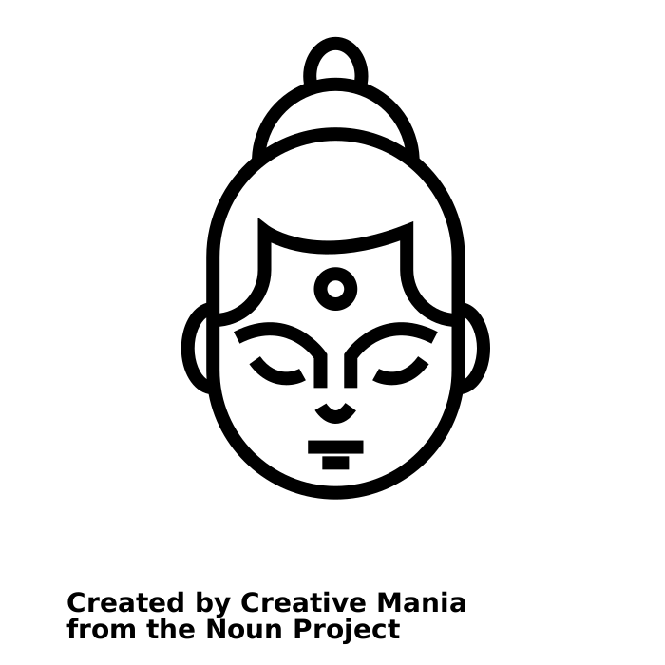
Subject learning journey – (RE)
Identify the core beliefs and concepts
Combat climate change
discuss various religions, key symbols, places of worship and celebrations.
Present values and concerns to a global audience
Green spaces
identify the key truth within The Christmas story
Christian beliefs and values
What do we now know about Christianity?
How and why do people care about the environment?
The Christmas Story
What can we learn about religious diversity in our area?
How do religions and beliefs respond to global issues?
Give examples of how stories show what people believe (e.g. the meaning behind a festival)
Protect natural resources
list key similarities and differences between the two gospel accounts of The Christmas Story;
locate local churches and mosques.
Enhance human health
To respect religious rituals
Investigate different religions, celebrations events
Global goals
Religion Diversity, Christianity, Global Issues
YEAR
Acceptable forms of behaviour and activities.
6
Discuss the meaning of Easter
Jewish beliefs and how they are expressed.
Ritual
Why we celebrate Easter
Why are good Friday and Easter Day the most important days for Christians?
Explore
forgiveness in a biblical text.
What Christians believe about Easter
Christmas Story
Abraham made to God
about the ten commandments
what a ritual is
That the Bible uses stories to tell us why Jesus and his teachings are important.
Recite ten commandments
How are Jewish beliefs expressed?
The importance of rituals from different religions.
That there are two books in the Bible: the Old and New Testaments
The impact of beliefs and practices
Judaism in the community
Beliefs and practices of Jewish people
how people express belonging.
about the significance of Moses
Describe the significance of places of pilgrimages and explain, with reference to religious beliefs.
Why is the Bible important to Christians?
Moses, the Torah
Beliefs about God.
Recap the Christian religion and what they believe in
Explore story of Passover and how its celebrated
That the Bible is an important book to Christians.
That the New Testament tells the stories of Jesus
YEAR
commandments, Psalms, songs and prayers, stories from the Torah.
the Creation story
the Christians believe God is the Holy Trinity
5
The British Pilgrimage Trust
Events and Projects.
Name places of pilgrimage and describe, with support, the significance of these pilgrimages.
Judaism, Christianity and Rituals
Judaism and Christianity
Exploring the synagogue.
What happened at the last supper?
what happened at the last supper
Newcastle Reform Synagogue
What is pilgrimage?
Talk about food used for different purposes, such as celebration or remembrance
Rituals in Judaism and the impact of this upon individuals
how any why people pray
why the last support is so important to Christians
Link their own beliefs to their and other people’s actions.
Know that Buddhists believe life is a journey to Nirvana and is affected by our actions and behaviours
Identify where India is on a map.
.
Explore the Jewish festivals of:
Rosh Hashanah, Hanukkah, Sukkot, Passover, and the Sabbath.
Know that Abraham founded Judaism.
Explain what a pilgrimage is;
Food and Fasting
What are the aspects of the Buddhism faith.
What is the Judaism Faith?
Understand that Jews believe there is only one god.
Discuss the role of food in different religions and communities
identify challenges that others have faced.
People of faith. How my beliefs impact my life?
Know that Siddhartha Gautama was the Buddha
Understand that Jews live by ten key rules.
identify what beliefs are and name some of their own.
Make a Wesak lantern.
YEAR
Retell one of the stories celebrated during a Sikh Festival and explain why the Guru Granth Sahib is considered to be the last Guru
4
understand that they have their own choices to make and begin to understand the concept of morals.
People of faith, food and fasting, Pilgrimage and Buddhism.
Describe who Jesus was and his importance to Christians
Why do Christians call Jesus the light of the world?
Design a Christian symbol
Explore
viewpoints
about one of
Jesus’ miracles.
Explore
different ways
in which Sikhs
share.
What is Sikhism?
To identify similarities and differences in different cultures through role play activities
show understanding of the trinity.
create a drama scene to show my understanding of one of the Ten Commandments
Learning the key parts of the nativity story.
Where Jesus was born and why.
Create a map to show where Islam was founded.
Name the founder of Sikhism and identify where Sikh’s worship.
Recap Year 1 learning the different religions in their local area
How Do Hindus Worship?
Explore Hinduism and understanding that they worship many gods.
What can we learn about the Nativity Story?
use a route planner to answer simple questions based on Mary and Joseph's route from Nazareth to Bethlehem;
What are the key aspects of Muslim Beliefs?
Explain who the key prophet was.
What can we learn about our local faith communities?
Hindus have many festivals and one of them is Diwali
Investigate the festival of Diwali and the story of Rama and Sita.
Explore Hindus worship in a temple
Find out how the nativity story began and the journey undertaken.
Use a script to create a documentary about Muslim festivals.
Use calligraphy to list the main Muslim beliefs
Identifying different religious buildings and what they represent.
YEAR
Hinduism, Christianity, Islam, Sikhism and Judaism.
What do Christians celebrate on Good Friday?
How Buddhists pray and why.
3
Sequence images of the Easter story.
• Reflect on positive things they could do for a friend.
• Write a prayer which says sorry.
• Complete a fact sheet about Maximilian Kolbe.
Create a tissue paper cross to express both the sadness of the crucifixion of Jesus and the happiness of the resurrection.
Design an Easter egg which shows new life.
Where Buddhism originated from.
Linked to shrove Tuesday, Ash Wednesday.
Recall what
Christians
believed
happened on
Easter Sunday.
Why people give gifts at Christmas
Name religious symbols and the meaning of them.
What do Christians believe about God?
How do Buddhist show their beliefs?
How do Christians celebrate Easter?
What is Kirpan?
Why is Christmas important to Christians?
Why is the Bible special to Christians? What can we learn about the story of St Cuthbert?
Why is Sikhism important to Sikhs?
symbols associated with Buddhism and what they represent.
What meaning of Easter?
The events of the Easter story and what happened
What is Sikhism? Compare to Christianity?
The events in the nativity story and what happened
Understanding the meaning of Christmas
Why the Bible is important to Christians?
Christian beliefs and values
Christianity, Sikhism, Buddhism and Local Faiths.
YEAR
Describe the main festivals of a religion.
2
Gurdwara Siri Guru Singh Sabha
Newcastle
Visit/ vistors
Explain religious rituals and ceremonies and the meaning of them, including their own experiences of them.
Recognise, name and describe religious artefacts, places and practices.
To identify similarities and differences in different cultures through role play activities
Why is Jesus special to Christians?
What is the Easter story?
Religion in the community
Why are gifts given at Christmas?
Why Jesus is special to Christians.
Learning about the teachings of the Bible through stories
Why we celebrate Easter.
What Christians believe about Easter
Investigating different religious buildings and what they represent
Religions in their local area
Develop an understanding of, what a Christian is and what they believe.
What the Bible is and why it is so important to Christians
The events of the Easter story and what happened.
Why is Christmas celebrated?
Christianity, Buddhism and Religion in the Community.
Newcastle Buddhist Centre
What is the meaning of Christmas?
Describe the main beliefs of a religion.
What Buddhists believe and what morals they follow.
why
What can we find out about Buddha?
Where Buddhism originated from.
What Christians believe about Christmas Day?
Who Buddha is and where he came from.
Christ church North Shields
YEAR
Family, Creation, Thankfulness
Children explore Christianity and Judaism and explore special stories and places of multitude of religions and celebrated festivals.
1
What can we learn about Christianity?
What do Christians believe about God?
Christianity and Judaism- The celebration of Christmas , Easter , Shrove Tuesday and St David’s Day.
Muslim celebration- Eid and Ramadan
Hancock Museum – Christmas celebrations
Chinese New Year
Hinduism- Diwali
Christianity, Judaism and Cultural Celebrations
EYFS
They know about similarities and differences between themselves and others, and among families, communities and traditions
Children talk about events in their own lives and the lives of family members.

