Slide 1
To help keep a consistent format - please use font: Calibri (Body)
Please use this web link to add any images:
Noun Project: Free Icons & Stock Photos for Everything (thenounproject.com)
Please copy and paste the timeline markers
Red – Playing instruments – Pulse, rhythm and melody
Green – Playing with sound/active listening
Blue – composition and improvision
Blue – Reviewing reflecting and evaluating music

Slide 2
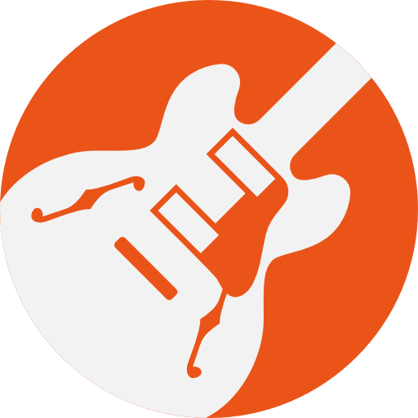
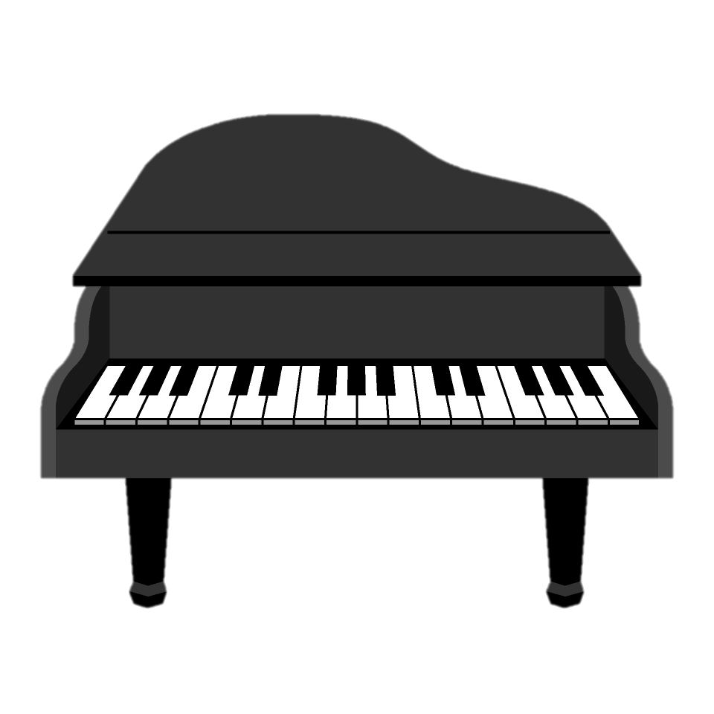
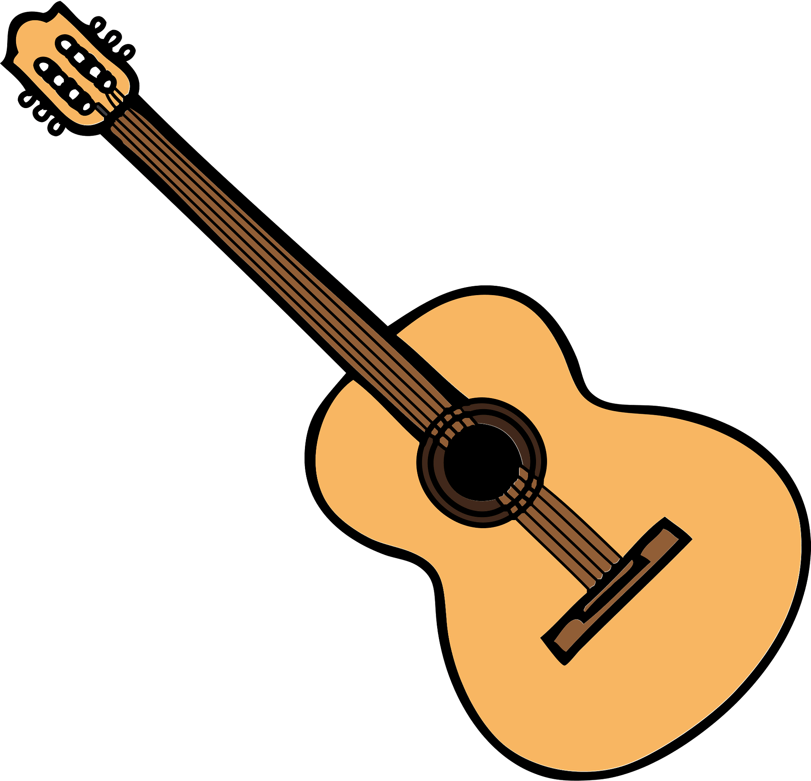
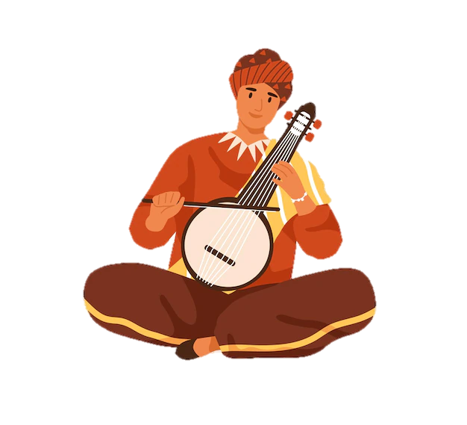
Subject learning journey – Music
YEAR
Expressive Arts
13
Famous female composers
Who is Amy Beach?
Inspirational music
Classical music on Garage band
Mozart
Elements of Mozart
What is classic music?
Requiem
Romantic
O mio Babbino caro
Recognising Romantic
19th century music
YEAR
12
Classical Music
Music Art Project
Music has layers and textures
Fusing Styles of Music
Art of Wassily Kandinsky
Beethoven
Beethoven Biography
The 5th symphony
Who influenced Beethoven
Opera
Costumes scenery and props
16th century Italy
4 components of opera
Blaydon Races
Traditional local music
The four chord trick
Traditional arrangements
Folk Music
The history of the guitar
The three chord trick
Stories origins and history
Calypso Music
A history of Calypso
Steel pan band
The Caribbean sound
YEAR
Traditional Music
11
Traditional Instruments
How instruments are used to communicate
Timbres and instruments
Different wats to use instruments
African Drumming
West African music
How signals are used in structure
Improvising creative Rhythms
A trip to Latin America
Wind instruments
The role of percussion instruments
What pitch do we use
The Notting Hill Carnival
Celebrating Black culture
Caribbean influence in the UK
Ska, Mambo and Merengue
Carnival Rio de Janerio
What is samba?
Bossa Nova beats
Basic samba percussion
Jazz Fest
New Orleans sound
The New Orleans Indians
Funerals and Celebration’s
YEAR
10
Music Festivals
Planning a festival
Marketing and advertising
Costs and budgeting
Target Audience
Glastonbury
A history of the festival
How green is Glastonbury?
A modern festival
Woodstock
60s Music
Cultural impact
Defining a generation
Rock n Roll
What inspired rock and roll?
Famous R n R Musicians
12 bar chord structure
Reggae Music
What is Reggae Music?
Rhythmic features
Musical appreciation
Soul Music
All about the Supremes
What is Soul Music?
Instrument sound and rhythm
Music – Beethoven to Ed Sheeran
YEAR
9
ABBA and Pop Music
Catchy Melody and lyrics
The history of Pop music
Creating a chorus
Hip Hop/Rap Music
Creating beats and loops
How to create a sample?
The history of Rap music
Dance music
History of dance Rythms
Producing music
Repetitive beats
Music Technolgy
Producing electronic music
Recording music
Mircophone’s and software
Adding Effects
Sound and audio Effects
Shaping your sound
Create movement with effects
Drum Patterns
Percussion drums and beats
Primitive beats
Boom Bap
YEAR
8
Dance Music – Sequencing sounds
Repetive Beats
Dancefloor – A history
Strong regular patterns
Drum kit workshop
Recording Audio
Music on your phone
Dictaphones
Voice effects
Loops and Samples
Using loops and samples
Music maker
Splicing sounds
Harmony
What is harmony?
‘Elefantea Nun Da’
Vocal percussion
Different voices different genres
Vocal warm ups
Volume projection and confidence
Whispering to Screamimg
Singing textures
Vocal warm ups
projection and confidence
Breathing Techniques
YEAR
Singing - What can our voices do?
7
Exploring Emotions through Voice
Techniques used to convey emotion
Decisions made in music
Composing music based on Emotion
Stomp and Sing
Why are pulse and rhythm important
Using our voice to mimic
What can the human voice do?
Beat Boxing
Creating music without instruments
vocal percussion and groove
What sounds can we make

Slide 3
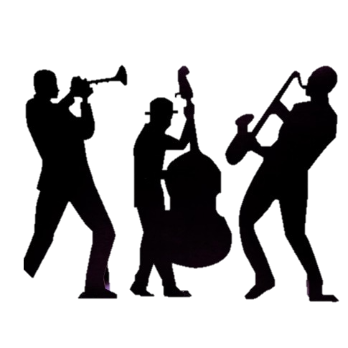
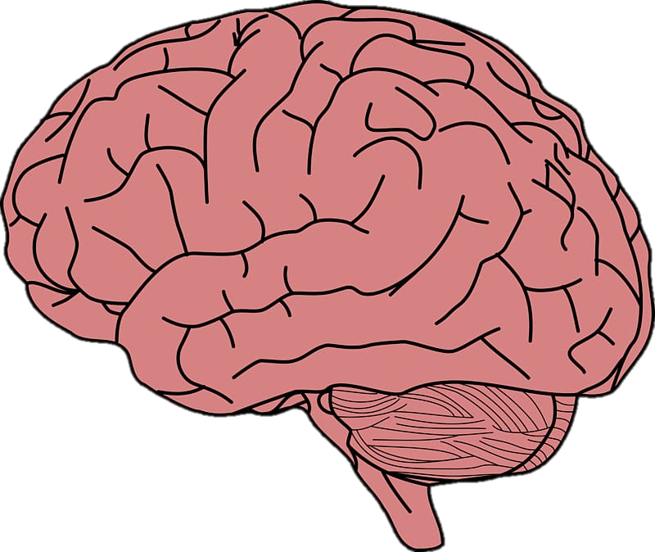
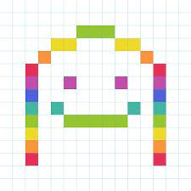
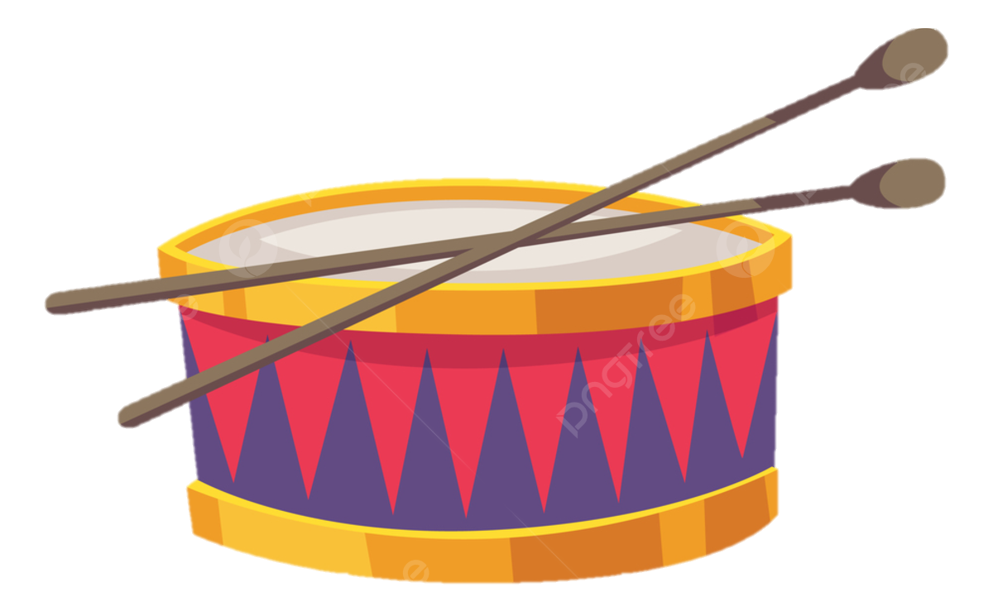
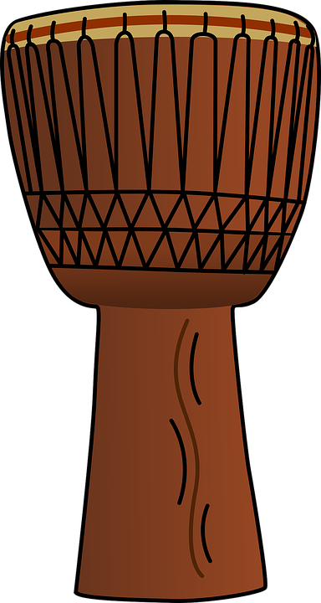
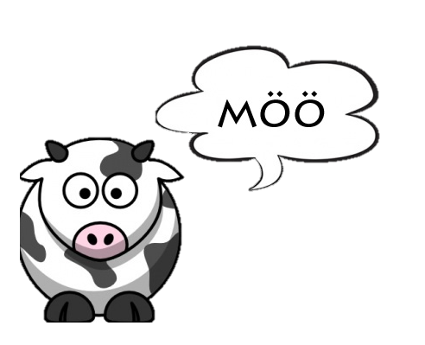
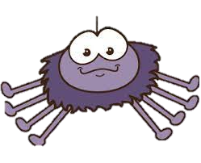
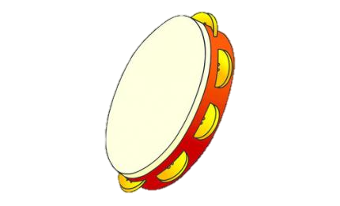
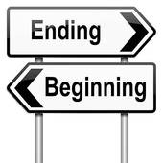
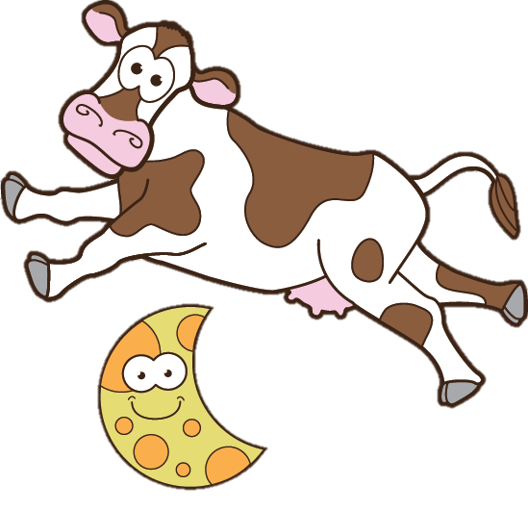
Subject learning journey – Music
Music and Identity
Use a range of IT sequence and record music
Experiment with Cluster of notes
Compose music that will surprise, unsettle and move
Add harmonies that fit these melodies
A New Year Carol
Song Writing
Listen and express thoughts to music
Playing with sound and composition
Rythmic patterns and beats
Happy
Pulse and rhythm
Conventions of pop music
The meaning of Tempo
Understanding Tempo in music
YEAR
Composition and improvisation
6
Reflect, Rewind, Replay
Sing songs using sound buttons
Sing songs in a variety of styles
Showing musical expression
Sing two/three part rounds with more confidence
You’ve got a friend
Rhythm Grids (clapping)
Linking to PSHE
Using tuned bells to create music
C scale tuned instruments
Classroom Jazz 2
Burt Bacharachs Songs
What is Blues music
Creating Jazz
Bank of Christmas Songs
Classroom Jazz
Classroom Jazz
Making Jazz
Pitch and dynamics
Bank of Christmas songs
Make You feel My Love
What is Pop Music?
Graphic notation ideas
Music Literacy to support sound
Musical instruments word mat
Reflect, Rewind, Replay
Sing songs from memory
Sing song in a variety of styles
Sing sings linked to an era
Create your own simple songs
YEAR
5
Understanding and playing simple notation
Livin on a prayer
Exploring pulse and rhythm
Exploring orchestra instruments
Rock and Roll activity
Pitch and dynamics
Fresh Prince of Bel Air
Hip Hop/Rap Music
Making Musical instruments
Rhythm grids (clapping)
Boom Wackers
Dancing in the street
Create music for instruments
Create your own simple songs
Create melodies to describe a character
Compose a jingle for an advert
Blackbird
Explore sounds to create effects
Combining and controlling sounds
Compose a short musical piece
Use IT to sequence, compose record work
Stop
Loud, Soft, Quiet songs
Teaching Music notations
Understanding melody
Exploring sound/Active listening
Mamma Mia
Exploring notes
Exploring action and voice
Pulse and Rhythm
What are pitch and melody
YEAR
Playing tuned and untuned percussion
4
Reflect, Rewind, Replay
Sing songs using sound buttons
Sing songs in a variety of styles
Showing musical expression
Sing two/three part rounds with more confidence
Lean on Me
The Beatles mini Topic
60’s Music
Playing with sound
Rhythm Grids
Glockenspiel 2
Melodies move up and down
What are pitch and Melody
Penatonic Scale
Bank of Christmas Songs
Glockenspiel 1 Christmas
Sense of hearing activity
High and low pitch – Glockenspiel
Bank of Christmas songs
Nursery Rhymes with a glockenspiel
The Dragon Song
European music
Styles of Music from British Isles
Listen and discuss styles of music
Playing with sound/active listening
Reflect, Rewind, Replay
Singing in a variety of styles
Sing with awareness of phrasing
Sing from memory
Compose short pieces of music
YEAR
3
Experimenting and creating sounds
Let your spirit fly
Exploring rhythm and melody
What is pulse and rhythm
Halloween songs
Pulse rhythm and melody
Three Little Birds
Introduction to Reggae
Sounds around us
Conveying mood
Change of speed
Bringing us together
Improvise short musical pieces
Combine sounds and music
Use a range of IT sequence
Record music
Friendship Song
Create Short repeated patterns
Identify different qualities of sound
Long and short sounds
Creating a sound picture
I wanna play in a band
Instrument sound plans
Supporting melody and notation
Musical story ideas
Listening to different Genres of music
Hands Feet Heart
Exploring African Music
Exploring pulse and Rhythm
African Drumming
Body percussion
YEAR
Active Listening and Response
2
Reflect, Rewind, Replay
Sing songs with more accuracy of pitch
Maintain a steady beat
Play fast or slow
Listen with increased concentration
Zoo Time
Animal Warm up song
Creating animal sounds
Animal boogie
Making Musical instruments
Ho Ho Ho Christmas Songs
Structure timbre and instructions
Christmas through movement
Teaching the Rhythm
Bank of Christmas Songs
Hey You
Sing familiar songs
Nursery Rhymes
Literacy through Music
Action Song
In the Groove
Exploring instruments
Explore different sounds
Instrument sounds
Creating rhythm
Your Imagination
Creating Structure
Beginning and End
Add sound effects
Use symbols to portrait music
YEAR
1
Promote singing and active Listening
Rhyme in the we walk
The Banana Rap
Copy Cat Rhythm
Body percussion Rhythm
Bank of Christmas Songs
Round and Round
Rhythm and Pulse Lessons
Teaching Melodies
Sorting and organizing sounds
Making musical instruments
Reflect, Rewind, Replay
Speak and Chant songs
Awareness of pitch
Playing tuned percussion
Active listening and response
Sea Shanties
Learning simple sea shanties
Imitate rhythms
Mark the beat
Imitate rhythms with tapping
and striking instruments.
Call and response songs
Echo simple short rhythmic phrases with untuned percussion.
Expressive Arts and Design
EYFS
Performing
Perform a small repertoire of short repetitive songs
Know further action songs and story ring games by heart.
Copy, memorise and perform a repertoire of simple hand action songs.
Move rhythmically
Use hands or feet to mark the beat
Dance with large arm movements using props
Body Percussion
Body percussion and instrumental sound effects to tell a story.
Discuss the pitch contrasts in tuned percussion.
Mark the pulse of pieces of music using body percussion.

