Slide 1
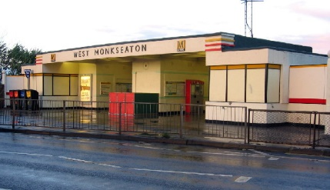
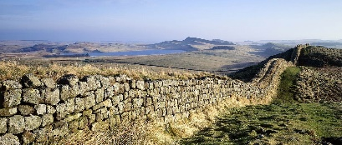
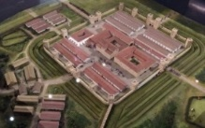
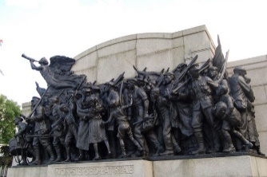
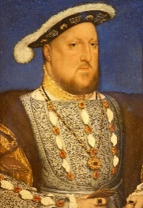
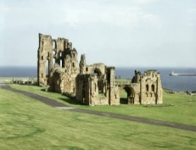
Subject learning journey – History
History Short Course Asdan
YEAR
Martin Luther King Day
13
Develop the
use of IT, English and Maths
Children in Need
Continue to develop
Historical skills
Develop functional
life skills
Plan and review activities
Learn how to cope with problems
Teamwork
YEAR
Gain and deploy a historically grounded understanding of abstract terms such as ‘empire’, ‘civilisation’, ‘parliament’ and ‘peasantry
12
History Short Course Asdan
Growing knowledge into different contexts, understanding the connections between local, regional, national and international history
Make connections between local history
Use historical terms and concepts in increasingly sophisticated ways
Segedunum Roman Fort and Museum
122 AD
400 AD
Roman Fort
Strong Fort
Roman Empire
Guard
Local History Study – Hadrian’s Wall and Segedunum
YEAR
11
Emperor
Hadrian
Defence
Wallsend
North East
Bowness-On-Solway
73 miles
Hadrian’s Wall
VE Day
Identify significant events, make connections, draw contrasts, and analyse trends within periods and over long arcs of time.
Holocaust Memorial Day
YEAR
Challenges for Britain, Europe and the wider world 1901 to the present day
Remembrance Sunday
10
Inter-war years
The Great
Depression
Second World War
Holocaust
Auschwitz
Soldiers
Jews
Draw contrasts, analyse trends
First World War
Discovery Museum
Make connections between local, regional, national and international history; between cultural, economic, military, political, religious and social history; and between short- and long-term timescales
Ideas, political power, industry and empire: Britain, 1745-1901
YEAR
Economy
9
Textile industry
Technological
Innovation
Factories
Mass-produced goods
Small cottage
industries
Industrial
Revolution
Black History Month
International Women’s Day
Understand how different types of historical sources are used rigorously to make historical claims
Beamish
Government
Discern how and why contrasting arguments and interpretations of the past have been constructed
YEAR
Early Modern Britain 1509-1745
Make connections
8
Cause and consequence
English Reformation
Henry VIII
Protestant
Continuity and change
Catholicism
Identify similarity,
difference
and significance
Tudors
Peasant Revolt
Great North Museum: Hancock
Castles
Medieval Banquet
Medieval jobs
Feudal system
Medieval town
YEAR
Medieval Britain 1066-1509
Magna Carter
7
Black Death
Medieval medicine
Medieval clothing
Understand the complexity of people’s lives, the process of change, the diversity of societies and relationships between different groups, as well as their own identity and the challenges of their time
National Nurses Day

Slide 2
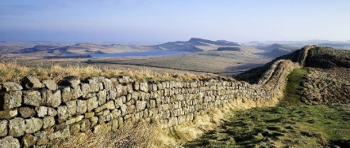
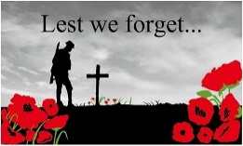
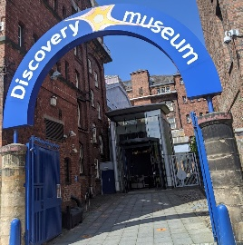
Subject learning journey – History
A study of a theme in British history that extends pupils’ chronological knowledge
Understand how our knowledge of the past is constructed from a range of sources.
Construct informed responses that
involve thoughtful selection and organisation of relevant historical information
Analyse Primary and Secondary sources
Riotous Royalty, Crime and Punishment, Leisure and Entertainment
YEAR
6
Regularly address and sometimes devise historically valid questions about change, cause, similarity and difference, and significance.
King John, Queen Anne
Commonwealth
National Anthem
Crime, punishment, judge, jury, court, trial, law
Roman, Medieval/Middle Ages, Victorian, leisure, entertainment
Holocaust Memorial Day
Turning point in British History
A non-European society that provides contrasts with British history
The Viking and Anglo-Saxon struggle for the kingdom of England
YEAR
5
Maya Civilisation, Vikings and Anglo-Saxons, WW1
Lindisfarne
VE Day
Civilisation, Mesoamerica, vigesimal number system, evidence, primary source, secondary source
William the Conqueror
Battle of Hastings.
Godwin of Wessex
Walter Tull
1914 – 1918
Remembrance Day
Romulus, Remus, legend, Roman Empire, aqueduct, Roman soldier, palaestra, caldarium, frigidarium, Roman fort
Invasion, Angles, Saxons, Jutes, Frisians, Scots, Picts, archaeology, historian, sources, evidence
Develop the appropriate use of historical terms
Hadrian’s Wall
Roman Empire and its impact on Britain, Anglo-Saxons, Pics and Scots, Ancient Greece
YEAR
4
Martin Luther King Day
Ancient, modern, Greece, chronology, empire, timeline, BC / AD
A local history study
Changes in Britain from the Stone Age to Iron Age
The achievements of the earliest civilizations
Note connections, contrasts and trends over time
Children in Need
YEAR
Bede Museum
Stephenson Steam Railway
St
Stone Age to Iron Age, Ancient Egypt, The Railway Revolution
Remembrance Sunday
3
National Nurses Day
Bonfire Night
Prehistoric, Stone Age
Bronze Age, Iron Age
Egyptian, artefact, hieroglyphics
mummified
Industrial Revolution
Steam Train
Nationalisation
Establish a clear narrative within and across periods
North East Land, Sea and Air Museums
Continue to develop a chronologically secure knowledge and understanding of British, local and world history
The First Aeroplane Flight, Kings and Queens, Nurturing Nurses
YEAR
2
Halloween
Queen Elizabeth II
Henry VIII
Queen Victoria
Florence Nightingale
Mary Seacole
Edith Cavell
The Wright Brothers
Monarch
King, Queen
Develop an awareness of the past, using common words and phrases relating to the passing of time.
Concept of time and things that happened ‘in the past’ ‘‘a long time ago’ and ‘now’
Understand where people and events they study fit within a chronological framework
Black History Month
transport
Childhood then and now, The Great Fire of London, Great Explorers
YEAR
1
toys
Pudding Lane
Use a wide vocabulary of everyday historical terms
Discovery Museum
1666
Neil Armstrong
Identify similarities and differences between ways of life in different periods
London
clothes
Christopher Columbus
Explorer
technology
Changes within living memory,
Significant Individuals
Events beyond living memory that are significant
International Women’s Day
school
Understanding the World
EYFS
Understand the past through settings, characters and events encountered in books read in class and storytelling.
parents
My story
Grandparents
Know some similarities and differences between things in the past and now, drawing on their experiences and what has been read in class
Talk about the lives of the people around them and their roles in society
stories

