Slide 1
Preparation for Adulthood Making Choices

Slide 2
Year 7
You will have a Person
Centred Review
You will discuss what is
working well.
You will discuss goals and aspirations.

Slide 3
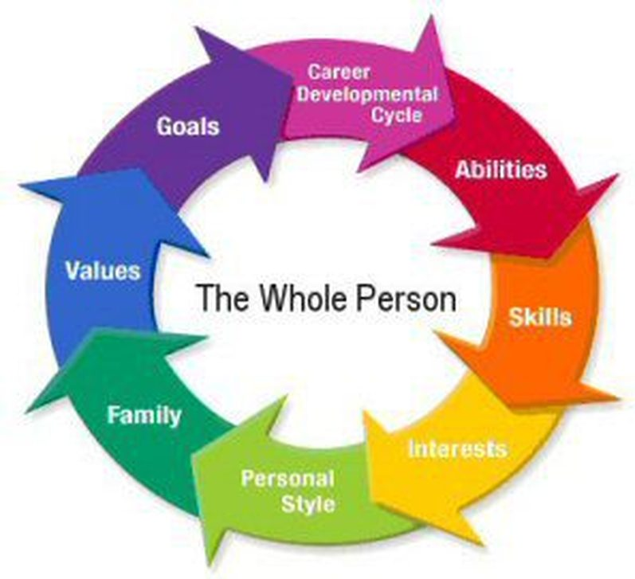
What is a Person Centred review ?
For you :Person Centred Reviews- a guide for young people and families - YouTube
For your parents/carers : Person centred reviews - YouTube

Slide 4
From Year 9
A Connexions adviser will attend your person Centred Review.
They will get to know you and your family.
They will come to your review every year and help you plan your next steps.

Slide 5
We will discuss your interests and which route you might take through school.

Slide 6
Which lessons you are good at and do you enjoy the most ?

Slide 7
At 16 years old you can make a choice! Stay for Post 16 or Leave for College
Check out our Prospectus
Post 16 | woodlawn

Slide 8
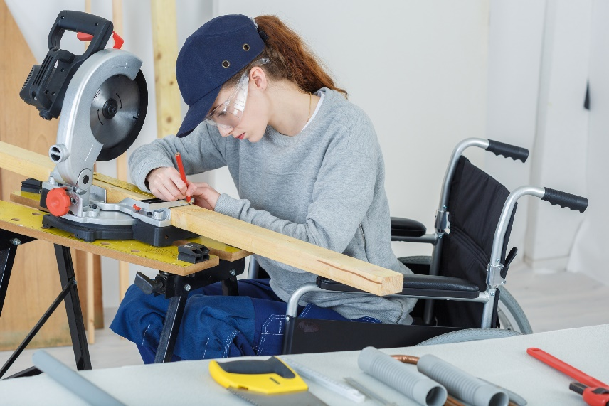
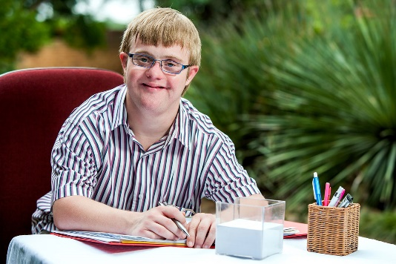
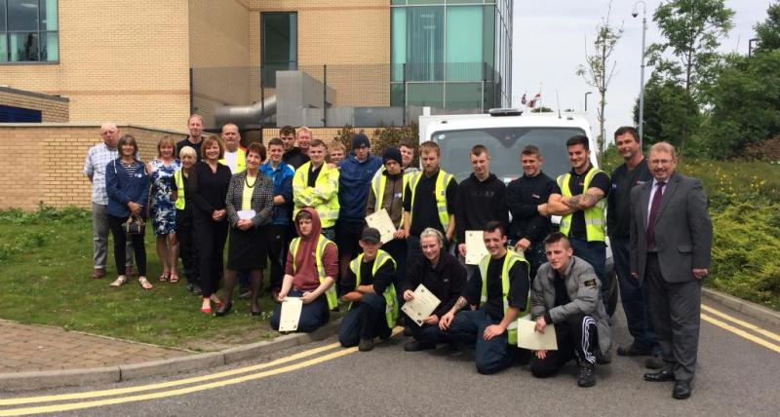
At 18 years old you make another choice!

Slide 9
We will help you every step of the way!

