Slide 1
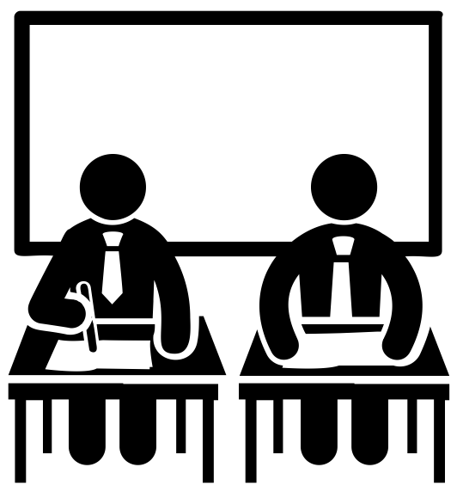
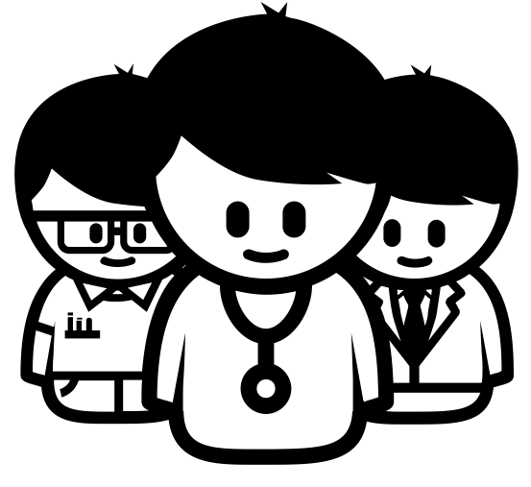
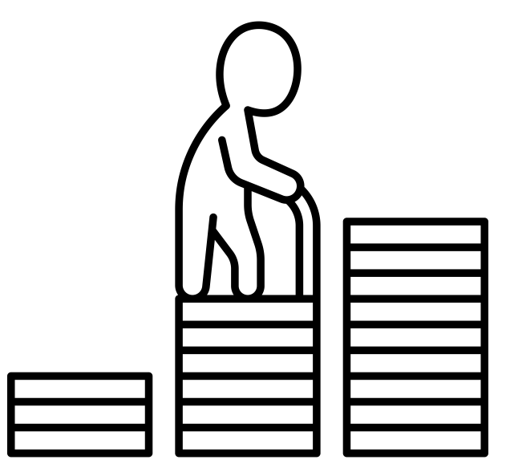
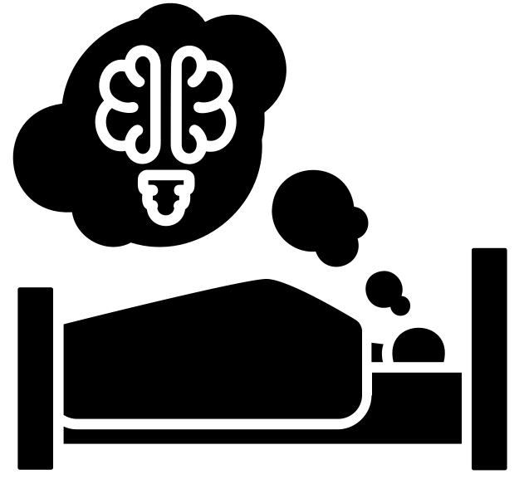
Subject learning journey – Careers
Connexions
Café Beam
Northumbria Youth Action
GCSE –
English
Science Maths
6th Form Cafe
YEAR
13
Science week/STEM week
Community Travel
Work Experience
GCSE –
English
Science Maths
Careers Week
YEAR
12
Careers Week
DWP
GCSE –
English
Science Maths
PSHE –
Careers and Work
Science week/STEM week
YEAR
11
Science week/STEM week
PSHE –
Careers and Work
GCSE –
English
Science Maths
Careers Week
YEAR
10
Careers Week
Money and Enterprise – what are risks?
Local Citizen – skills needed for WoW
Science week/STEM week
YEAR
9
Science week/STEM week
Maths in the real world
Better Attitudes/Dreams
Careers Week
YEAR
8
Careers Week
Human Rights
Desert Island – Creation of Society
Science week/STEM week
YEAR
7

Slide 2
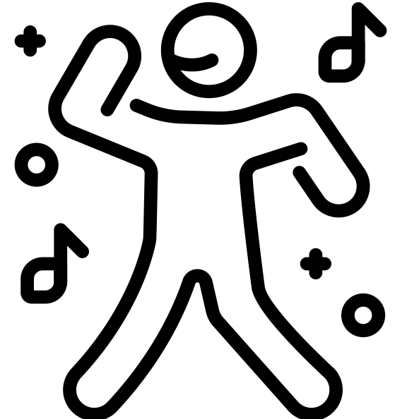
Subject learning journey – Careers
Why are jobs important?
Money Matters
YEAR
6
Science week/STEM week
All Around the World – How people live and work
Right’s and Responsibilities
Careers Week
YEAR
5
Careers Week
Famous scientists
Musician visits
Science week/STEM week
YEAR
4
Science week/STEM week
‘Going to hospital’ – roles of healthcare workers
Looking after living things
Careers Week
YEAR
3
Careers Week
Employability
Jobs in history
Science week/STEM week
YEAR
2
Science week/STEM week
Role-play – people who keep me safe
Rock pool School
Careers Week
YEAR
1
Timbadash Theatre
Little Movers
Role-play -
jobs
People in the community
Careers Week
EYFS

