Slide 1
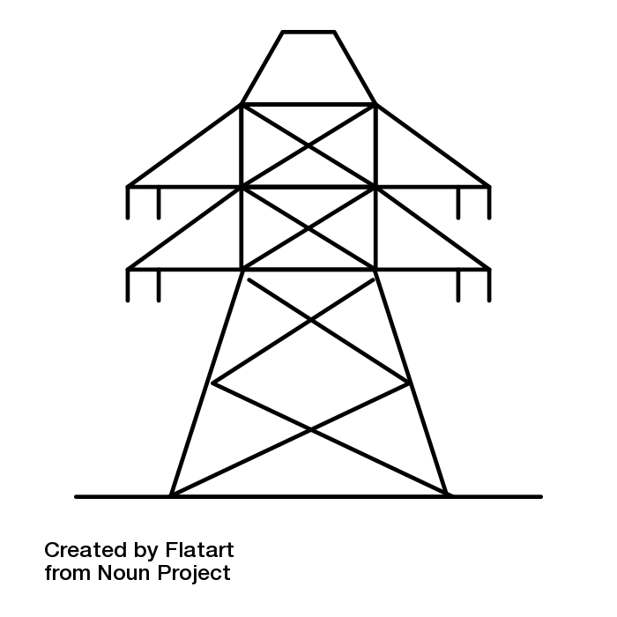
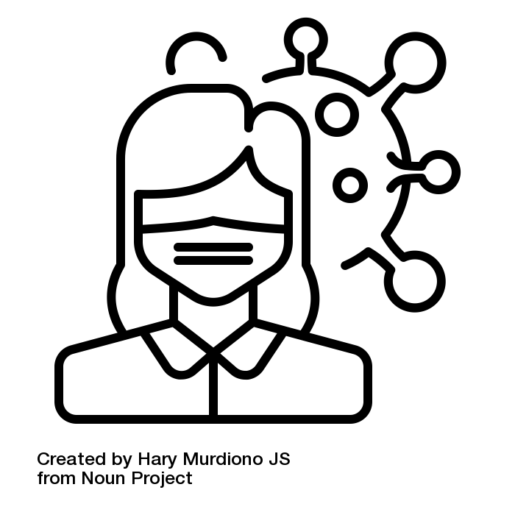
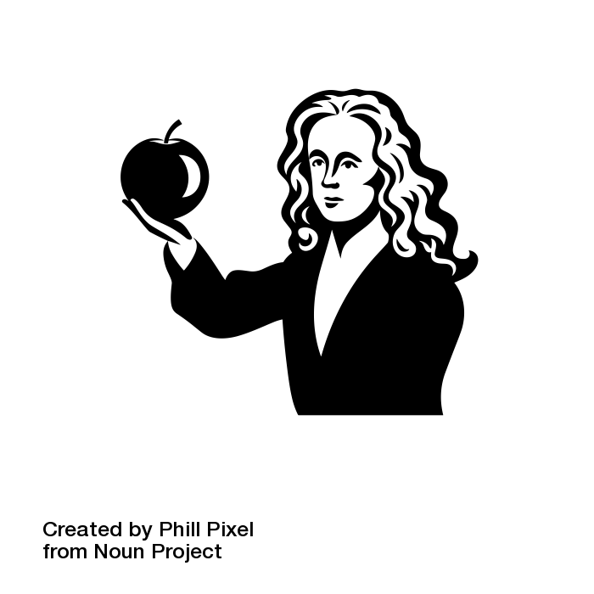
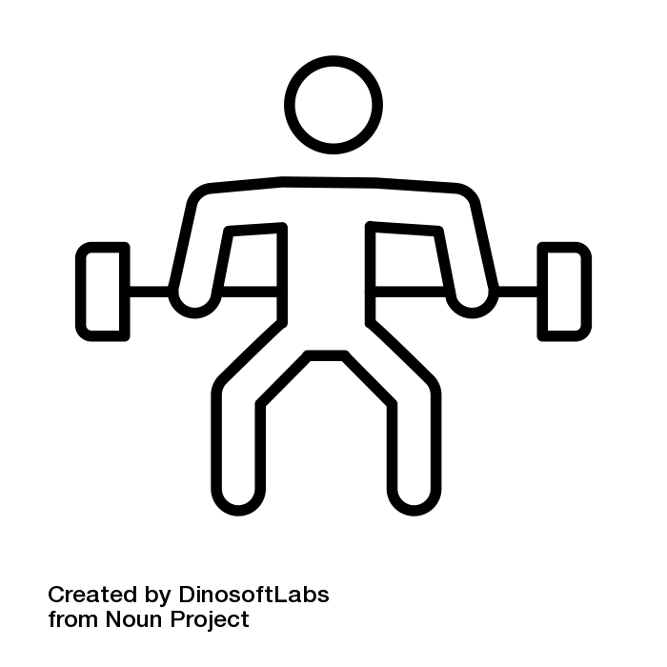
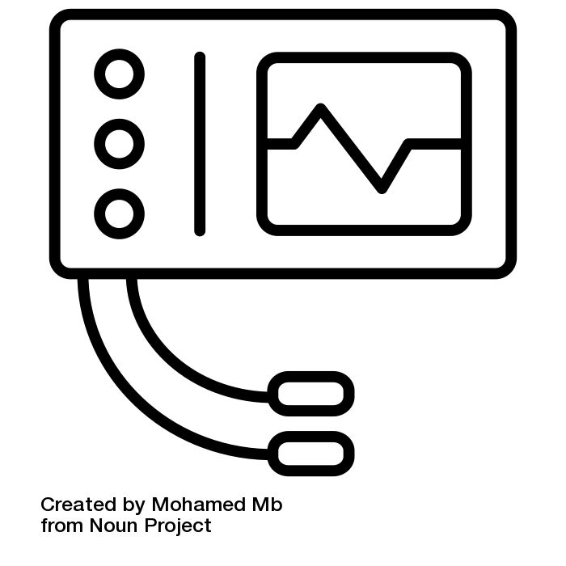
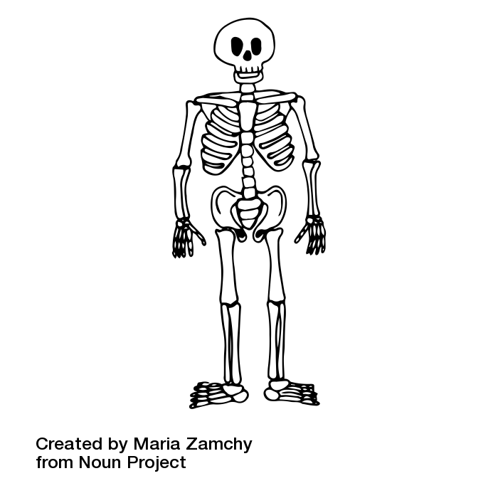
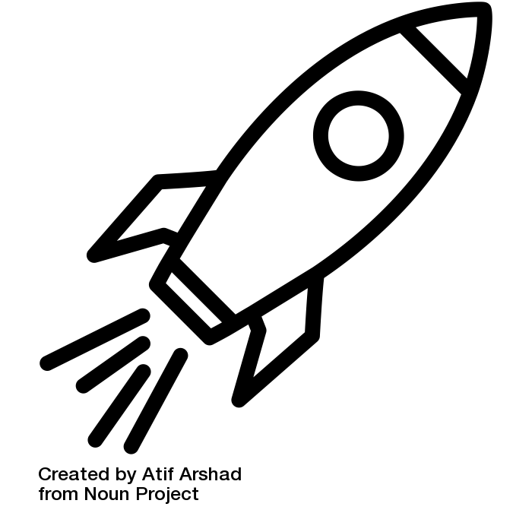
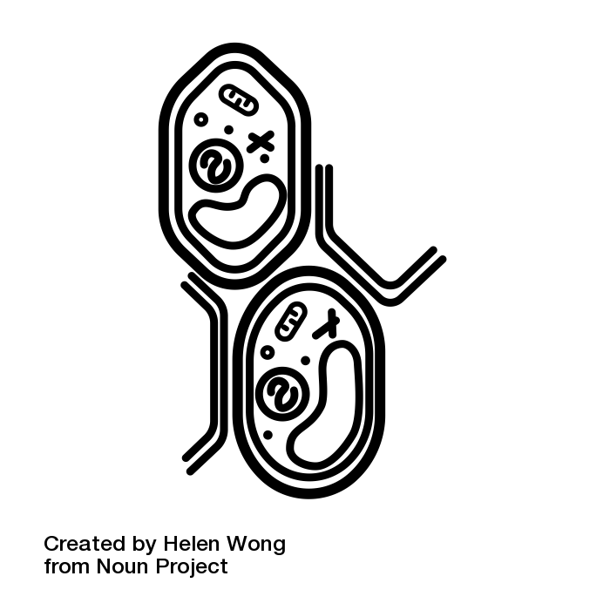
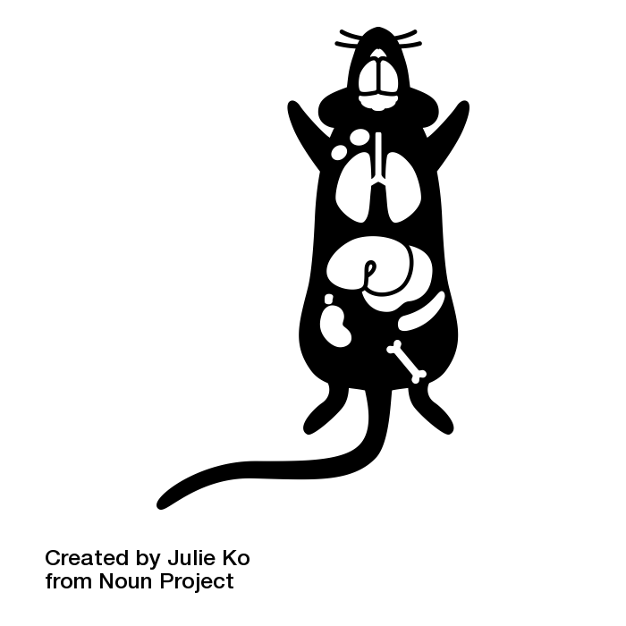
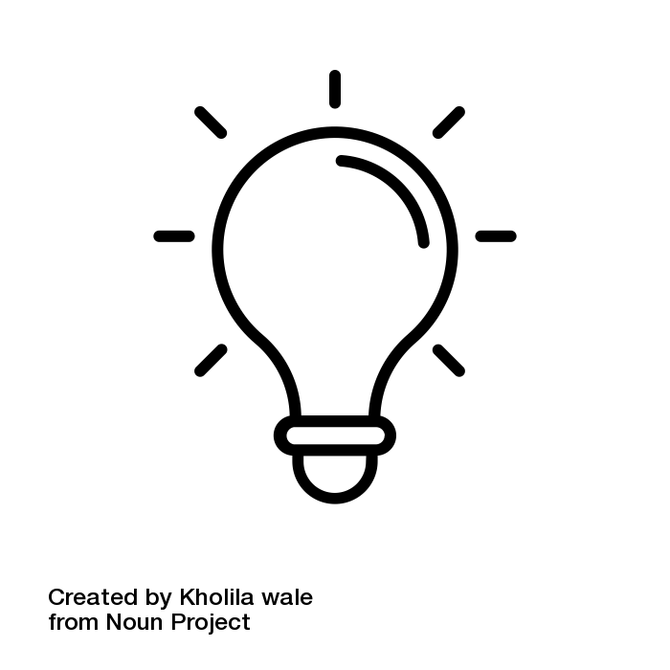
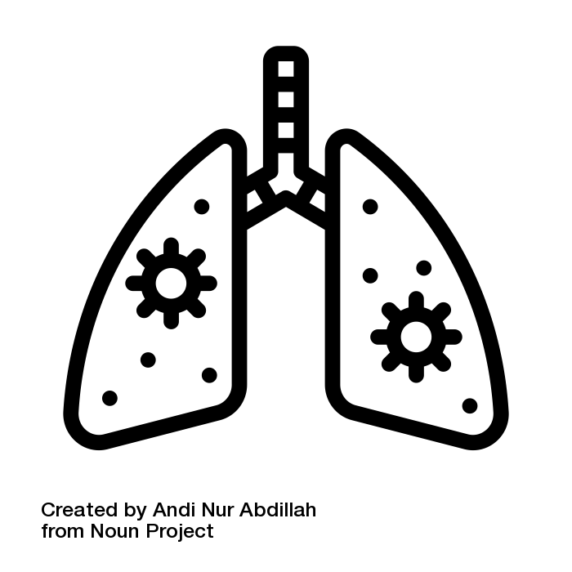
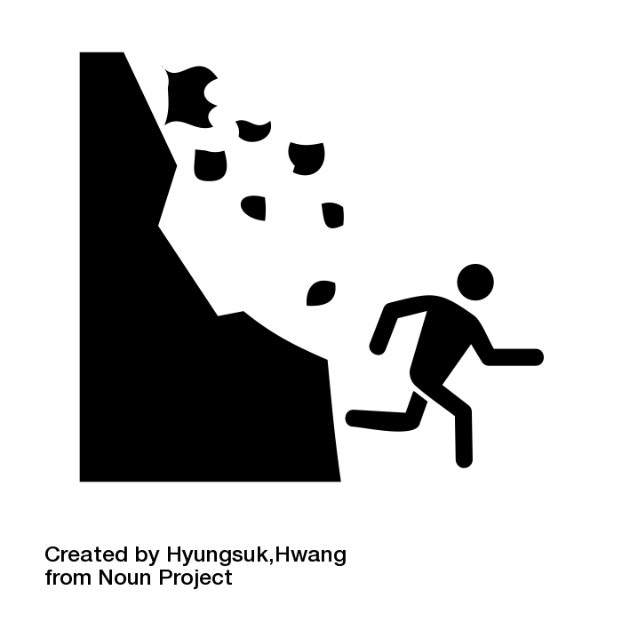
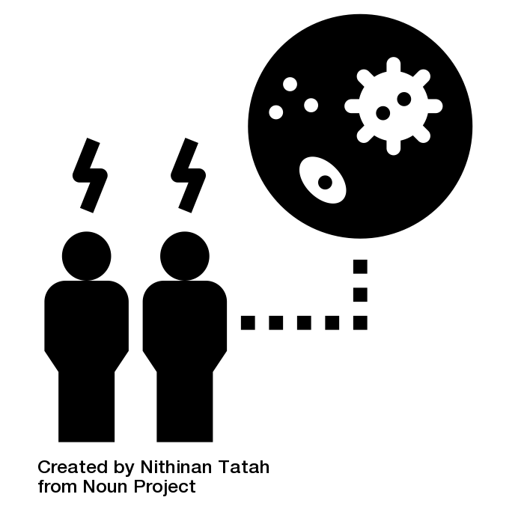
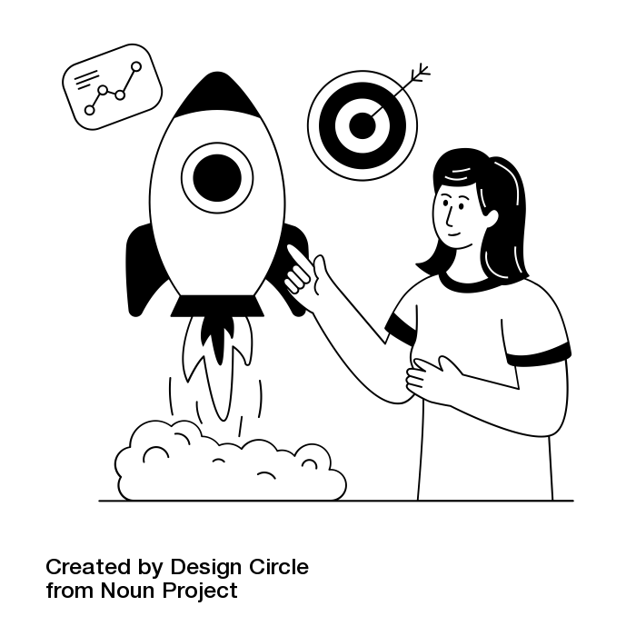
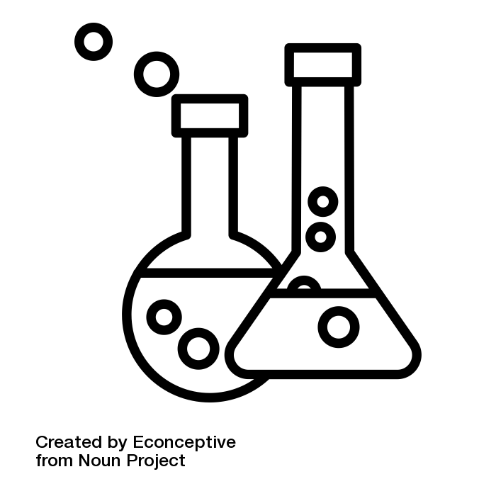
Received a phone call at 6:30pm 27th June 2023 from the trauma clinic to say that a doctor had looked at my hand x-ray and that I had fractures to the ring and little fingers of my right hand. They also said a letter is being sent to my home address including information about some physiotherapy.
Subject learning journey – Science
Revision and exam technique - Using resources including BBC bitesize.
Forces; Waves; and
Magnetism and
electromagnetism
Energy; Electricity
YEAR
AQA GCSE Combined Science: Trilogy – Year 2
13
Equals Semi-formal Curriculum
Accreditation -
Unit award Science - AQA
Individual units selected for
each class covering
The Human body,
Acids and Alkalis,
The Solar system etc.
Science Week
Particle model of matter;
and Atomic structure
Infection and response;
and Bioenergetics
Science Week
Quantitative chemistry;
Chemical changes; and
Energy changes
YEAR
12
AQA GCSE Combined Science: Trilogy – Year 1
Cell Biology;
Organisation
Homeostasis and response; Inheritance, variation and evolution; and Ecology.
Atomic structure and the
periodic table; Bonding, structure,
and the properties of matter
The rate and extent of chemical change;
Organic chemistry; Chemical analysis;
Chemistry of the atmosphere; and
Using resources.
Properties
of materials
Living things
and their
habitats
Evolution and
inheritance
Famous scientists
YEAR
11
The science
of sport.
Science Week
The human body and
living things
The skeletal and
muscular systems
Science Week
Waves – sound, energy
and light.
YEAR
10
Cells and
organisation
Relationships in
the Eco-system
Chemical reactions
Space physics
Properties of
materials
Evolution and
inheritance
Environment
Forces and magnets
YEAR
9
Light
Science Week
States of matter
Respiration
Eco-relationships
The Rock Cycle
YEAR
8
Food and
digestion
Disease
Science Week
Rocks and weathering
Space Project
Simple chemical reactions
Practical Science
7
The Solar System and Beyond
Science Week
Solids liquids and gases

Slide 2
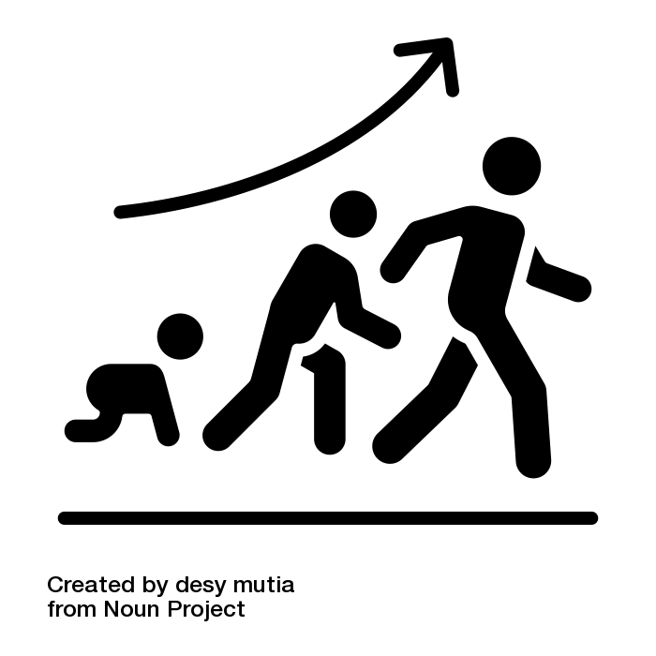
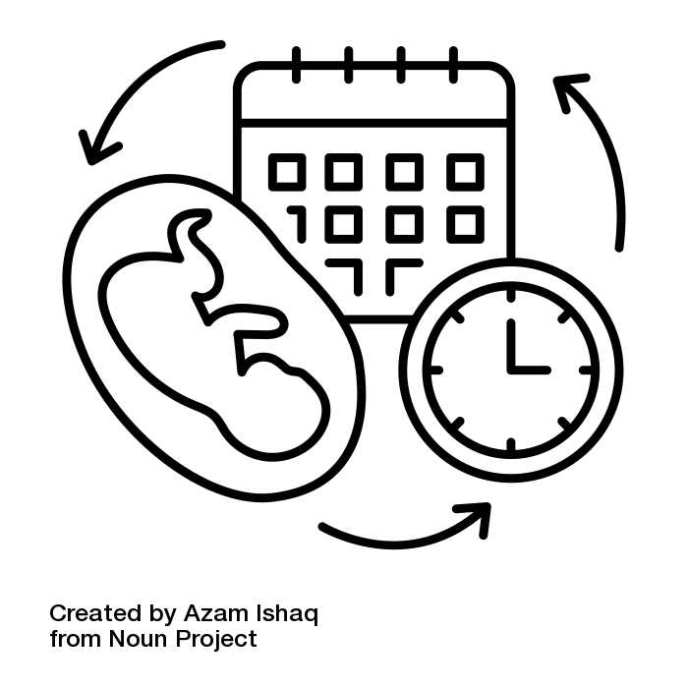
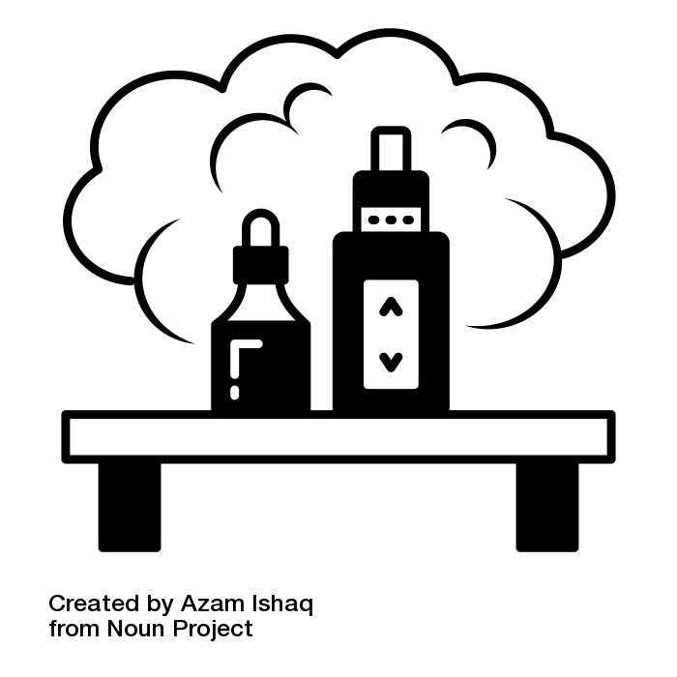
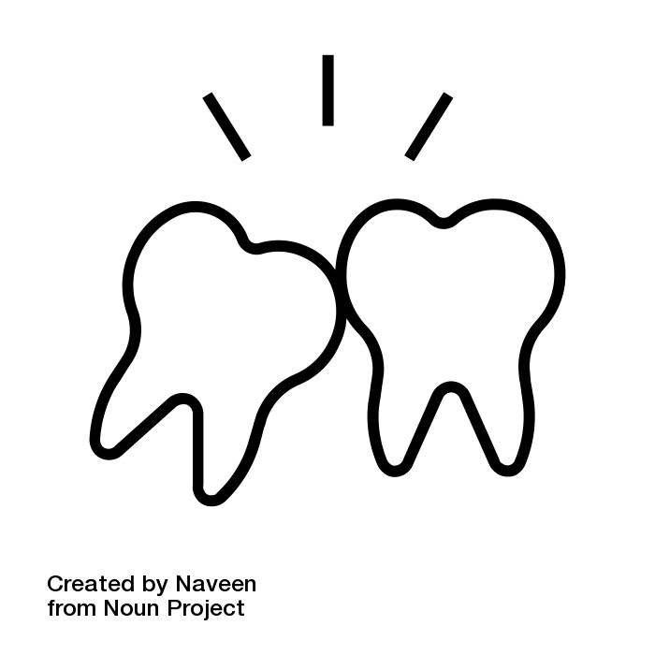
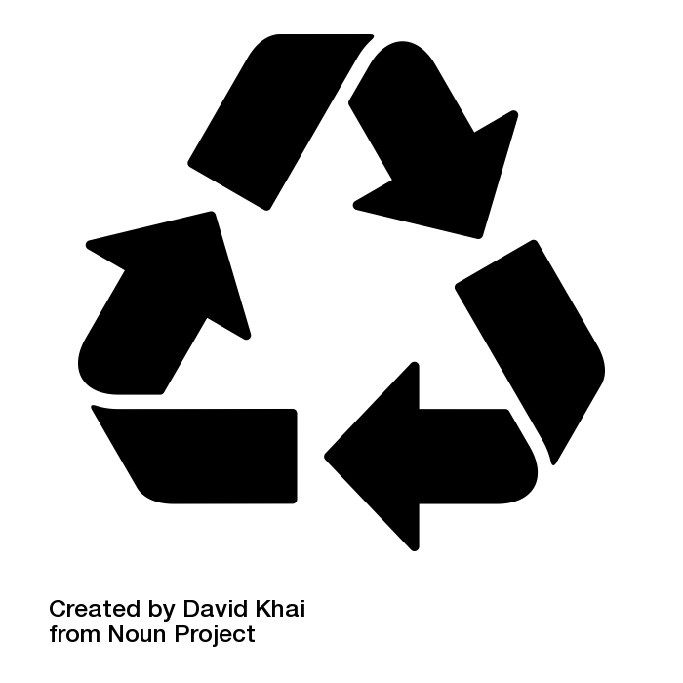
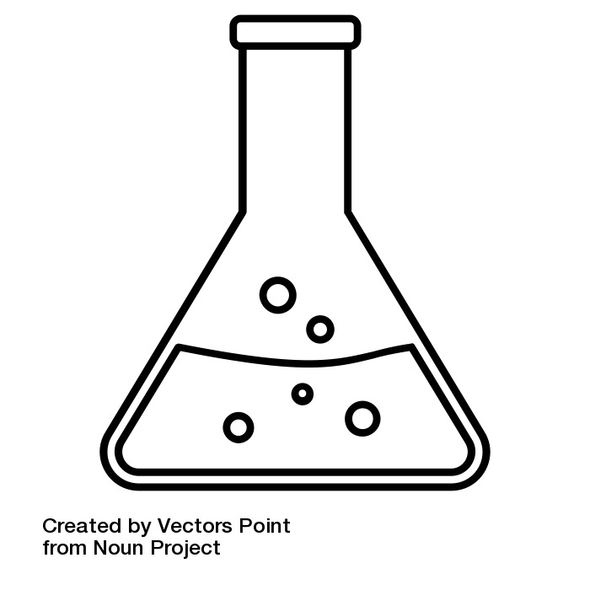
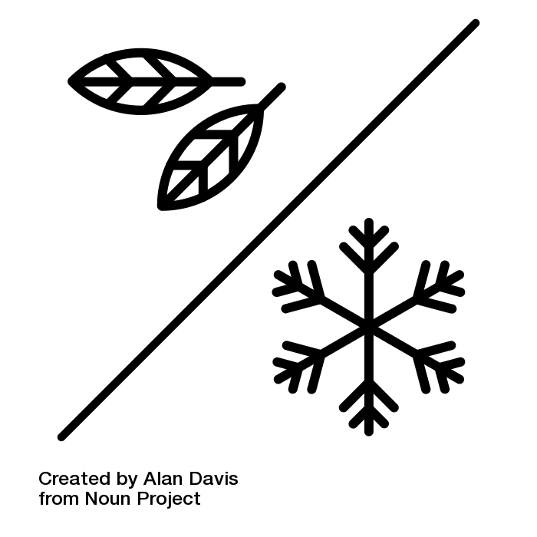
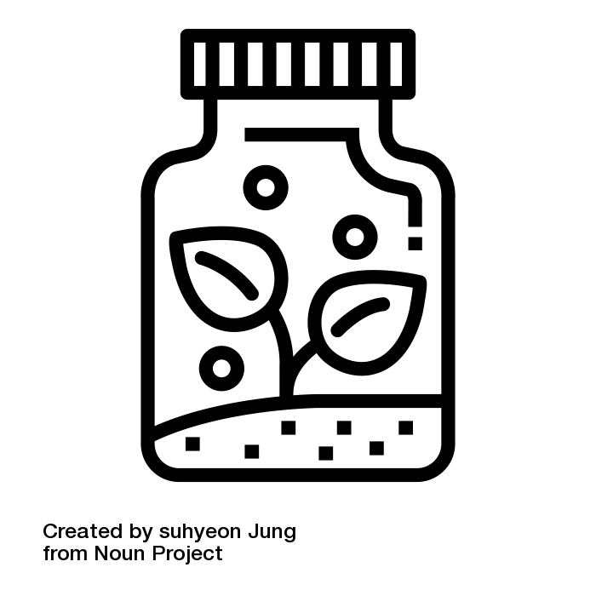
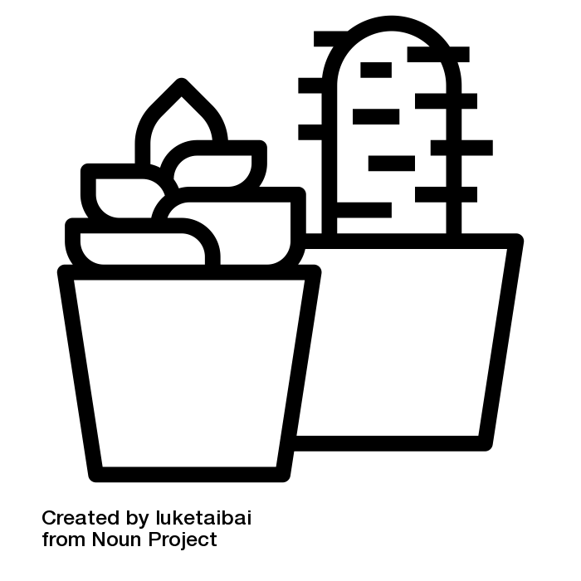
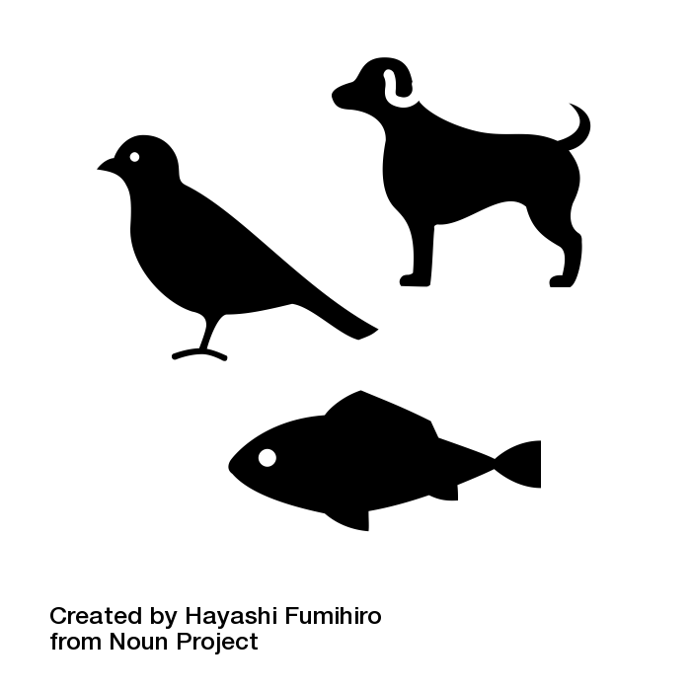
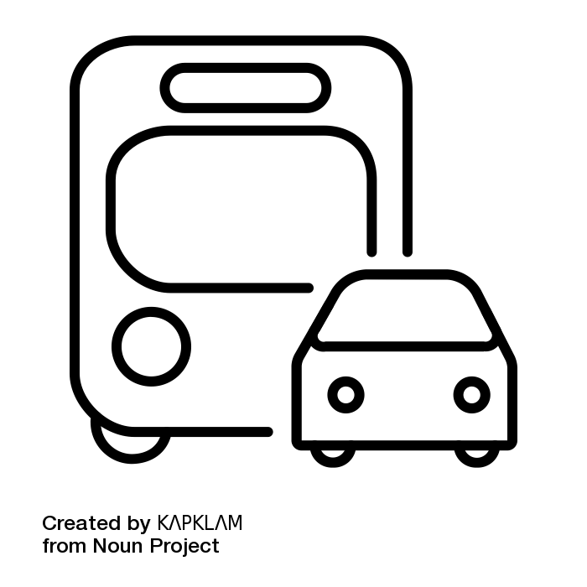
Received a phone call at 6:30pm 27th June 2023 from the trauma clinic to say that a doctor had looked at my hand x-ray and that I had fractures to the ring and little fingers of my right hand. They also said a letter is being sent to my home address including information about some physiotherapy.
Subject learning journey – Science
Working Scientifically-
planning enquiries to
answer questions.
Living things and
their habitats
Light
Animals including
humans
YEAR
6
Evolution and
inheritance
Science Week
Electricity
YEAR
Earth and Space – movement of
earth, and other planets around
the Sun.
Science Week
Forces – gravity, air and
water resistance and
friction.
5
Animals including
humans – changes as humans
develop to old age.
Properties and changes of materials – separating materials – filtering, sieving etc.
Living things and
their habitats – differences in
life cycles.
Working Scientifically – taking
measurements with increasing
accuracy.
Working Scientifically
record findings in
tables and charts.
Living things and their
habitats – habitats and
environments can
change – which leads
to dangers for animals
States of matter -
grouping solids,
liquids and gases.
Animals including
humans – digestive
system including teeth.
YEAR
4
Electricity – building
simple series circuits.
Science Week
Sounds – how sounds are made –
when something vibrates
Light – sources
of light and shadows.
Science Week
Plants – functions of
parts of plants.
YEAR
3
Animals including
Humans -functions of
skeletons and muscles.
Forces and Magnets –
some forces need contact
but magnets don’t.
Rocks and fossils – compare rocks –
How are fossils made?
Working Scientifically –
set up simple tests.
Working Scientifically
- perform simple tests.
Living things and
their habitats – name plants, animals
and their habitats.
Uses of everyday
Materials – compare suitability of
Materials for jobs.
Animals including
Humans – basic needs of animals
(water/food)
YEAR
2
Plants – seeds and bulbs grow
Into mature plants.
Science Week
The environment – reduce,
reuse and recycle.
Seasonal changes
Autumn/Winter –
observe change in weather.
Seasonal changes
Spring/Summer – describe weather
changes and changes in the length
of day.
Working scientifically –
observe using simple
equipment.
YEAR
1
Animals including
Humans – identify
common animals
Everyday materials –
Identify common
materials.
Science Week
Plants –
Identify common
plants.
Investigate changing materials - cooking Exploring differences in family members
Investigate different vehicles & how they move.
Exploring materials Explore living things.
EYFS
Exploring properties of materials.
Exploring life cycles & caring.
Science Week
Exploring lives of themselves and others.
Investigate light and dark. Explore properties of ice.

