Slide 1
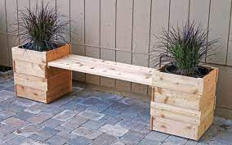
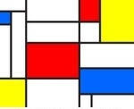
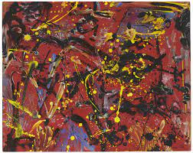
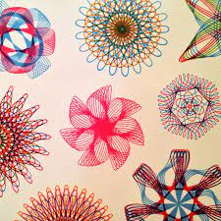
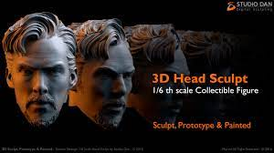
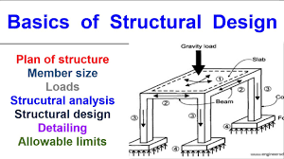
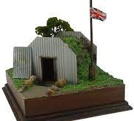
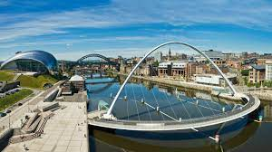
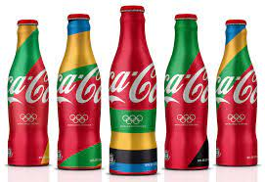
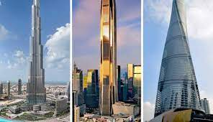
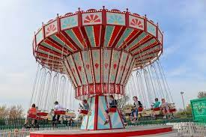
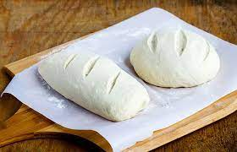
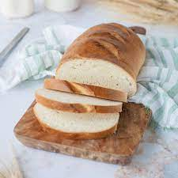
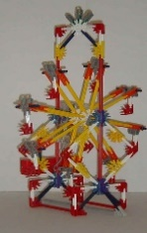
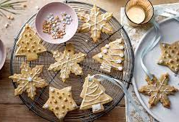
Alongside this students will continue to complete the module ‘Food safety at home and in the community’ learning about safe food storage and cleaning the food preparation area.
Subject learning journey – Design Technology
GCSE Photography
Introduction to Photography -short activities
learn a range of basic skills
gain an understanding of technical principles:
camera aperture, position and point of focus to control depth of field
camera shutter speed
explore the use of the camera controls present work in digital portfolios.
analyse photographic sources
document their response.
development their own ideas.
record ideas visually and through written analysis
GCSE Art and Design
Introduce students to a variety of short term activities related to the areas of study. Students explore and create work related to at least two of the following titles: Fine art, Graphic communication, Textile design, Three-dimensional design and Photography. Students experience a range of traditional and/or experimental ways of developing, refining and recording ideas.
Students are given the opportunity to fully engage with a theme and make a personal response. They learn to engage with the process of developing, refining and recording ideas
13
OCN level 1 in Photography
Basic camera settings and functions
Rule of thirds
Camera angles
Portrait and landscape orientations
Good and bad photos
OCN level 1 in Podcasting
Audio production
Journalism qualification
CV and employability skills
ASDAN Expressive Arts
The Expressive Arts Short Course will enable learners to:
-Learn and demonstrate techniques in different forms of expressive arts (eg visual arts, performing arts, music, 3D crafts, Graphic design writing.)
-Develop an awareness of how creative expression and enjoyment of the arts can have a positive impact on mental health and wellbeing.
develop their own creative voice and produce their own original work.
-Gain an understanding of the importance of arts and creativity in society and industry
12
Enterprise Product Design Wood work planters and bench. Christmas wooden Reindeer Sculptures
ASDAN Personal and Social Development
Food safety at home and in the community’ learning about safe food storage and cleaning the food preparation area.
To develop confident individuals who are physically, emotionally and socially healthy being responsible citizens who make a positive contribution to society and embrace change managing risk together with their own wellbeing.
Clay casting
Plaster casting
3D sculpture
Fashion and textiles
Costume exhibition
Basic sewing skills
Great Designers
11
Digital Graphic Design
Spirograph digital geometric drawing board automatically generates reflections of your drawn line, creating magical and perfect symmetry.
Piet Mondrian - MONDRIMAT
space, colour and visual rhythm in accordance with the theories of Piet Mondrian.
Jackson Pollock
Digital painting
3D digital sculpting
Wassily Kandinsky
Circles and Triangles
Digital Comics
10
STEM Week
Structure Design
Den design
design, build and evaluate structures
stable structure
Taro Chiezo
Lambanana sculptures Design ideas
Local architecture
Tonal drawing – render light-dark
Air Raid shelter design
Link to the Blitz
9
STEM Challenges
Dyson Challenges
Architectural challenges
Tallest building
Earthquake challenge
Strongest building
Graphic design
surface design trainer design – fashion design
London Olympics advertisements branding and consumerism
Matt Moore
Coca Cola design Ray –Ban
Bread making
The History Behind Warburtons
Evaluate Existing Products
Design Criteria and Shaping
Designing
Final Designs
Making and Evaluating Bread
8
STEM Week
All the fun at the fair
Funfair ride design and manufacture
The types of rides
How the rides move and materials they are made from
Target audience - theming
7
Musical Art
Explore the link between music and art, and how this had influenced many famous artists and musicians. We will develop our listening skills and create our own art pieces as a result of listening to different pieces of music.
Seasonal craft and design
product research, design, adapt and make products, before evaluation.
Biscuit making
Weighing ingredients
Design
Evaluation
- market research

Slide 2
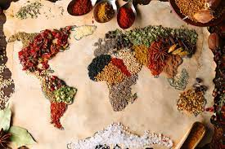
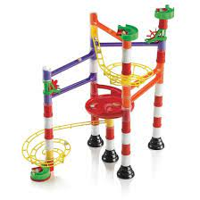
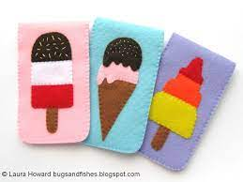
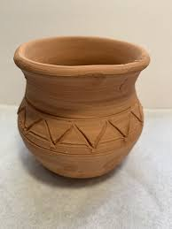
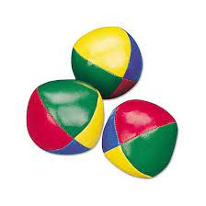
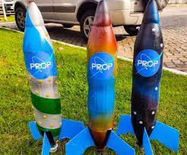
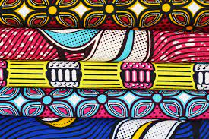
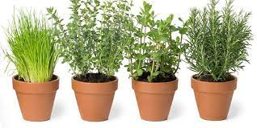
Subject learning journey – Design Technology
Automata animals
Cut materials accurately and safely by selecting appropriate tools. Assemble a simple cam mechanism as part of
the design. Use tools with some accuracy
Textiles: Texture
Beamish Project
STEM Week
6
Programming adventures
Understand how a floor robot moves. Program it accurately to move along a given route. Explore and select from a range of different materials to create obstacle squares.
Marbulous structures
Marble run bridges
Explore existing free standing structures strength, reinforcement and stability.
Select tools and equipment to join card together.
Seasonal Cooking
The importance of buying seasonal food. Where, when and how a variety of ingredients are grown, reared, caught and processed.
5
Understand and apply the principles of a healthy diet.
Felt Alien phone cases
Annotated designs to communicate ideas
Step by step plans and paper templates
Sewing
Evaluate design process.
Global food
Foods from around the world.
Investigate different cultures and make different world dishes.
3D Modelling
Viking and Anglo Saxon pottery
and create paper Mache battle
helmets
Greek Architecture
Structures
Healthy eating
STEM Week
Mechanical Posters
Components
Mechanisms
4
Kite design -Explain how Homan Walsh used a kite to help build the Niagara Falls Bridge. Use research into the shape and parts of kites to develop simple design criteria. Build simple frame structures.
What makes a good inventor?
Design and make inventions to solve world problems.
Design ideas. Create prototypes
Evaluate our invention
Battery operated lights
Switches
Simple circuits
Design and make light display Evaluate final products
Juggling Balls
Investigate a range of existing products. Develop a design based around a design criteria. Use appropriate techniques to decorate fabric. With support create a hem using a running stitch and join fabrics using an overcast stitch.
Canopic jars Egypt project
Rocket making
3
Tudor houses
African textiles and sculptures
Exploring different printing techniques on paper and fabric Creating own print designs. Geometric line drawings and clay sculptures
Healthy Lifestyles
Salad making – Edible garden
Explore where fruit and vegetables come from and our 5 senses and follow instructions to create different kinds of salads such as a fruit, ham and coleslaw and potato salad.
Junk 3D Construction
Using scientific knowledge of ‘everyday materials’ design and create different monsters to go with ‘Not Now Bernard’ story.
Junk modelling, Duplo, stickle bricks and natural materials to create monsters.
African Sculpture
2
Edible Garden
Naming & Growing Herbs
Pesto and Pasta
Sweet Strawberries
Strawberry Smoothie
Tasting & Growing Tomatoes
Cooking with Tomatoes
Lego robots – computing links
3D Construction: making gas masks
Moving pictures Traditional tales
Fabric Bunting
Pirate Paddy’s packed Lunch problems
Weaving
Sewing skills
Develop snack preferences
Participate in simple domestic role play imitating routines and actions
Prepare a snack showing basic control giving out plates, cups and passing food.
Making a Monster
Fabric faces
Scientific
knowledge of ‘everyday materials’
1
Use simple eating and drinking equipment independently
Builds with blocks
Hammering games to build eye coordination and consistency
Fills and empties containers with water and sand using cups, scoops, spoons and spades.
Healthy eating
Sensational salads
Explores simple joints and mechanisms in everyday objects and construction kits.
Remote control toys
Create own action games such as water flow structures and simple wheeled vehicles from construction kits. Give a very simple explanation of how they work.
Join materials for a purpose
Demonstrate how to achieve a particular goal with pulley systems, ride on toys and digger toys.
Properties of everyday materials
EYFS
Make mechanisms such as peg board cogs and other simple construction kit components such as wheels and axles.
Make marks with large tools using arms and shoulders
Weave materials into frames
Develop techniques for working simple mechanisms
Sustain interest in action and retraction toys
Using a fork and spoon
Demonstrate a hand preference

